Slide 1
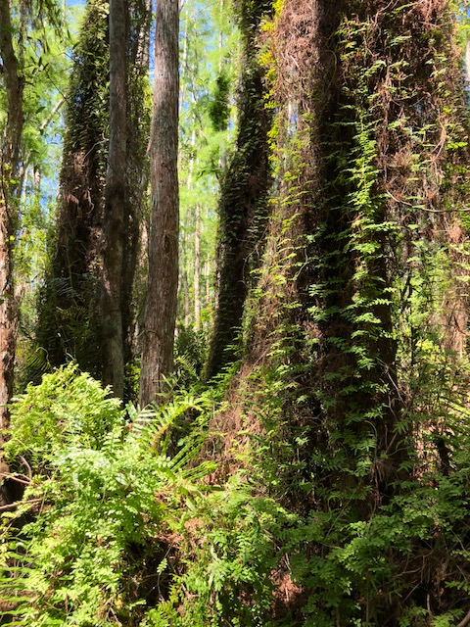
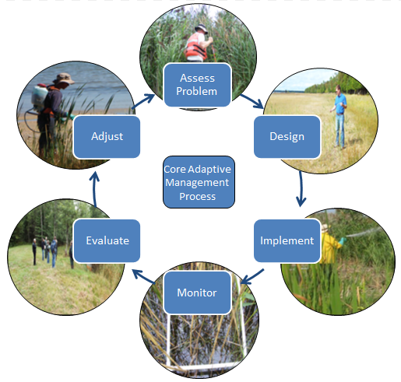

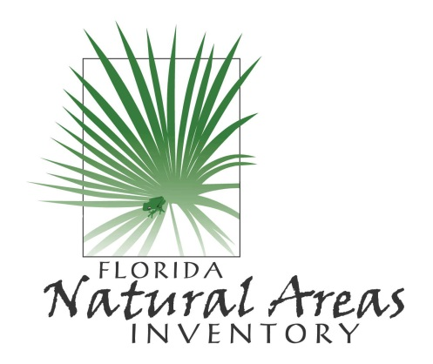
Post-Herbicide Monitoring
Dexter Sowell, Ph.D.

Slide 2
Agenda:
Class Portion (10am-12pm)
-overview of field ID characteristics of herbicide-treated species
-reviewing aerial maps, habitat maps, tracklogs and weekly progress reports to determine locations and timing of inspection
-what, where, and how to look for invasive species when on an inspection
-methods of data collection and estimates of effectiveness
-forming recommendations for follow-up treatments
-group discussion
Lunch
Field Portion-~1pm-2:30pm
-hands on work with different data collection units, estimating infestations, and finding and identifying the target species in the field.

Slide 3
The Value of Monitoring
Helps to document problem and show success of treatment
Prioritize and save time and money when the contractors arrive
“If you’re not monitoring, you ain’t managing…at least not adaptively”
Notes:
Part of CISMAs strategic plans: Encourage CISMA partners to use FNAI for large census/polygon and distribution data.

Slide 4
The Value of Monitoring
Notes:
Part of CISMAs strategic plans: Encourage CISMA partners to use FNAI for large census/polygon and distribution data.

Slide 5
Level of Monitoring?
The dilemma…
Systematic random sampling takes too much time and can be expensive, but has the most credibility.
Casual observations are likely to be too biased, not reliable, not repeatable, or not “court-worthy” but is rapid way to assess some known problem areas.
Notes:
Part of CISMAs strategic plans: Encourage CISMA partners to use FNAI for large census/polygon and distribution data.

Slide 6
Level of Monitoring?
TIME AND MONEY
-high bias,
-low repeatability
-low certainty
-low bias,
-high repeatability
-high certainty
BUT, there is a middle ground and it doesn’t have to take long to be complicated to get you the information you need!
Notes:
Part of CISMAs strategic plans: Encourage CISMA partners to use FNAI for large census/polygon and distribution data.

Slide 7
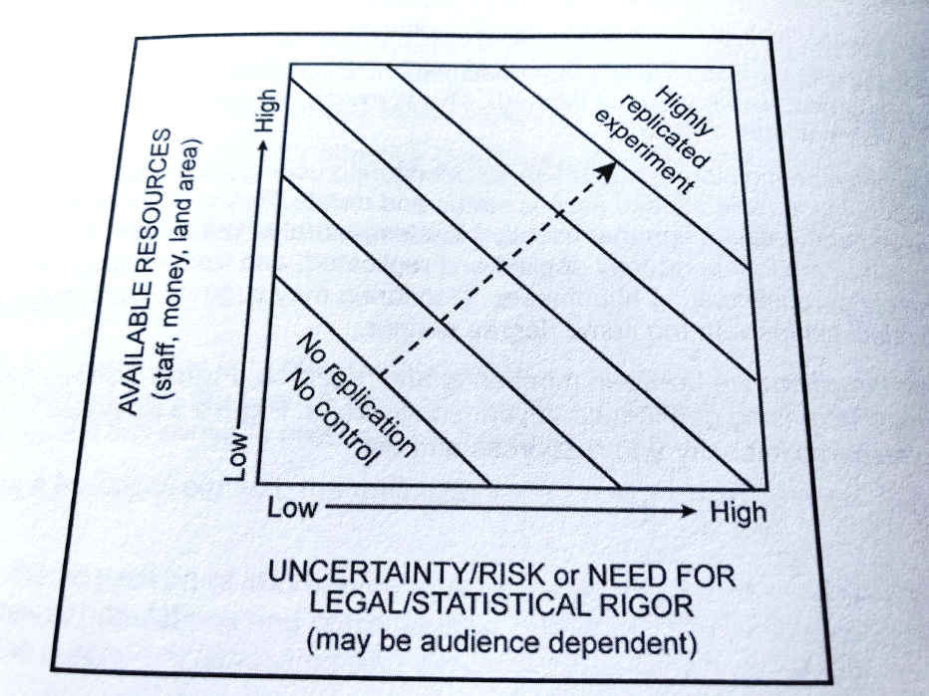
Level of Monitoring?

Slide 8
Level of Monitoring?
Could be negatively impacting the resource
Could be wasting FWC Money
Could be unfair to the contractor
Could be missing opportunities to learn something about one of your main mgmt. actions!

Slide 9


Determining % Control
2 Factors
100% coverage-?
95% control-?

Slide 10
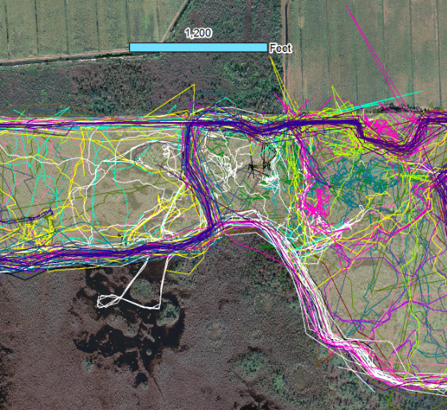
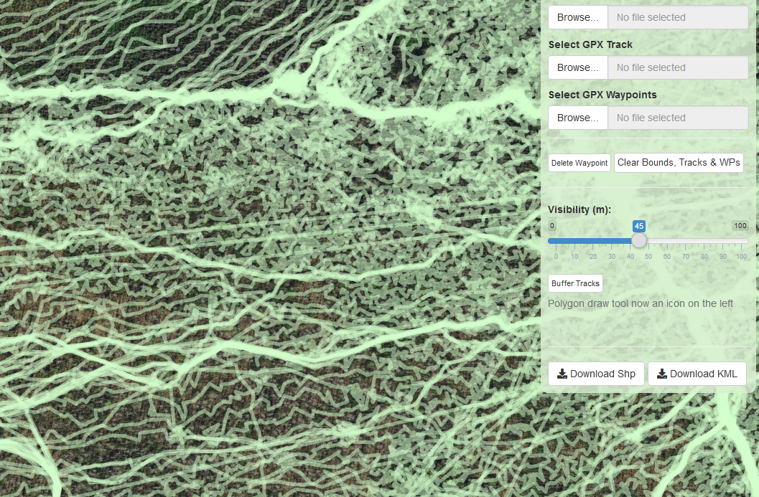
PRE-POST-Treatment Monitoring
Investigate tracks DURING THE BIG PROJECTS
How fast? How far apart? Where? When?
Notes:
So, the first thing we do is investigate the tracks, look at the target species, habitats, resources in the area. The picture is an examples of one way we can interpret really busy tracks through creating a line density to see where the contractors spent the most time.

Slide 11
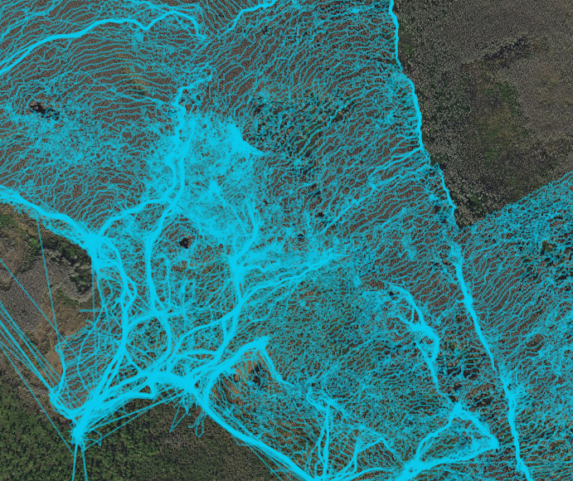
Post Treatment Monitoring
Investigate tracks
Look for travel routes
Problem areas
Gaps
For big projects this should be done as a check in before they get too far
Notes:
So, the first thing we do is investigate the tracks, look at the target species, habitats, resources in the area. The picture is an examples of one way we can interpret really busy tracks through creating a line density to see where the contractors spent the most time.

Slide 12
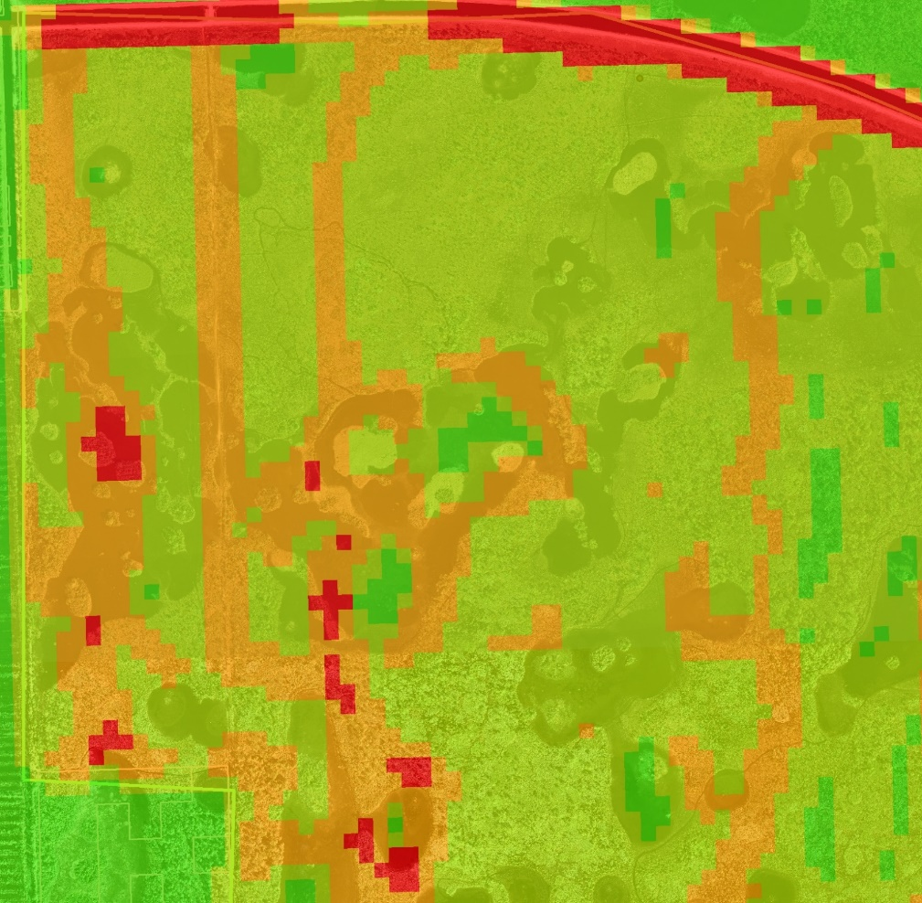
Post Treatment Monitoring
Investigate tracks
Look for travel routes
Problem areas
Gaps
Notes:
So, the first thing we do is investigate the tracks, look at the target species, habitats, resources in the area. The picture is an examples of one way we can interpret really busy tracks through creating a line density to see where the contractors spent the most time.

Slide 13
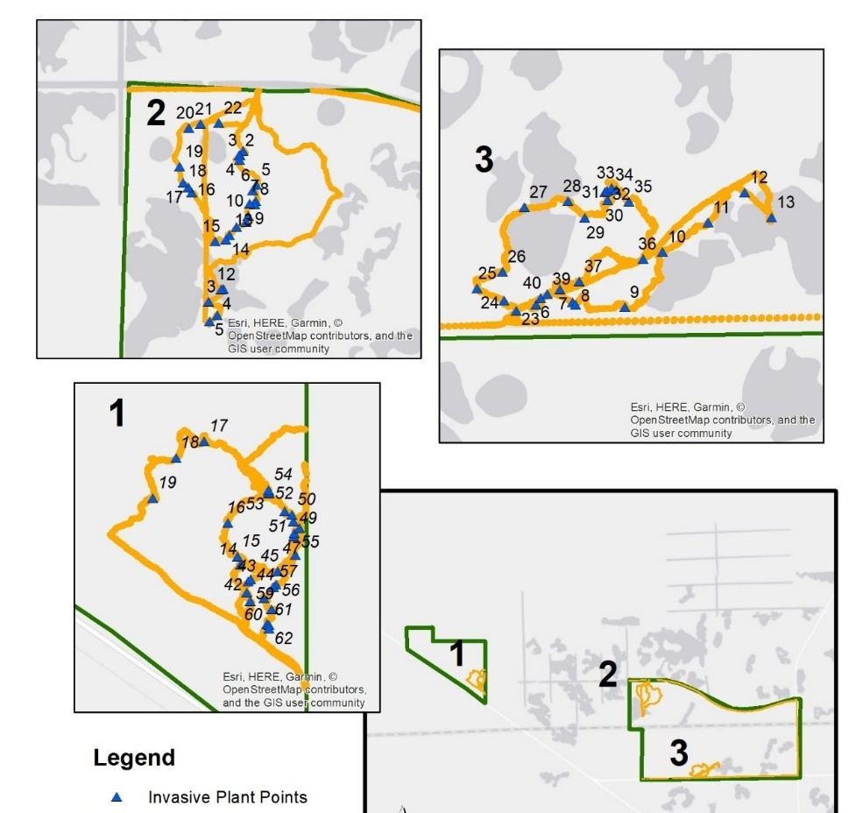
Post Treatment Monitoring
Investigate Tracks
Survey Methods
Equal time person/effort defined
by project areas
Meander high and low coverage areas
Take points at every treated and untreated occurrence
Estimate gross size of infestation
Assign cover class of pre-treatment (dead & live) and post-treatment (live only)

Slide 14
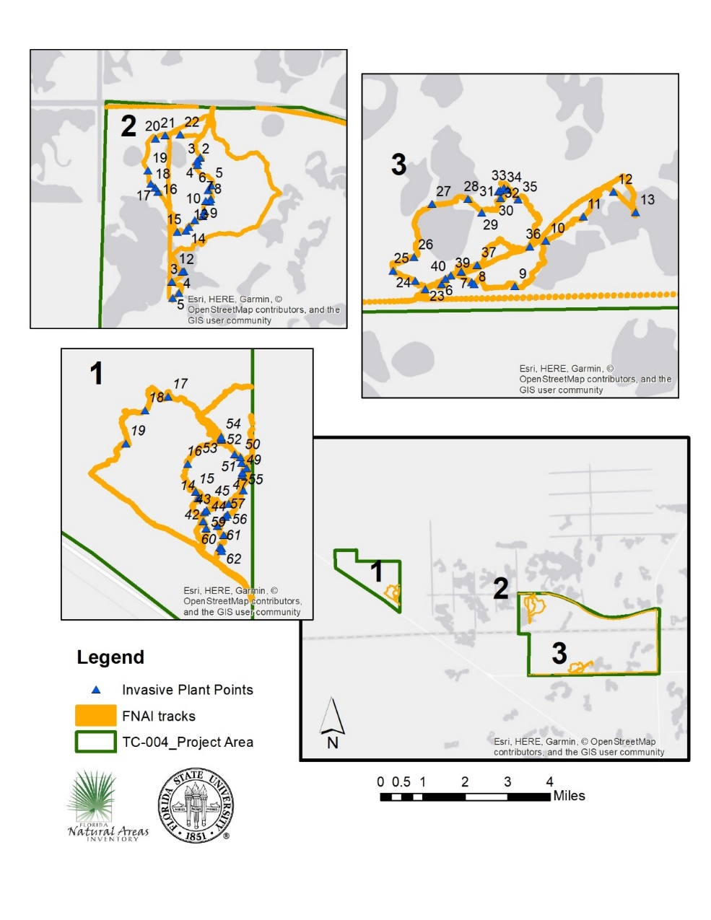
Post Treatment Monitoring
Investigate Tracks
Survey Methods
Data collection and Entry
We use Trimble/Terra Sync and analyze/manage data in ArcGIS/excel
But, you could use any device with Arc Collector, Survey 123, GPS device with Trackinator/excel, etc.

Slide 15
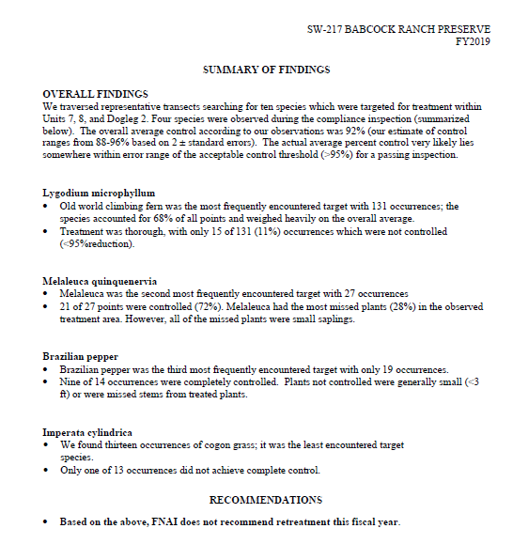
Post Treatment Monitoring
Investigate Tracks
Survey
Report
Form
Additional information page
Photos and Maps
Notes:
Our reports usually consist of photos with examples of what we found.

Slide 16
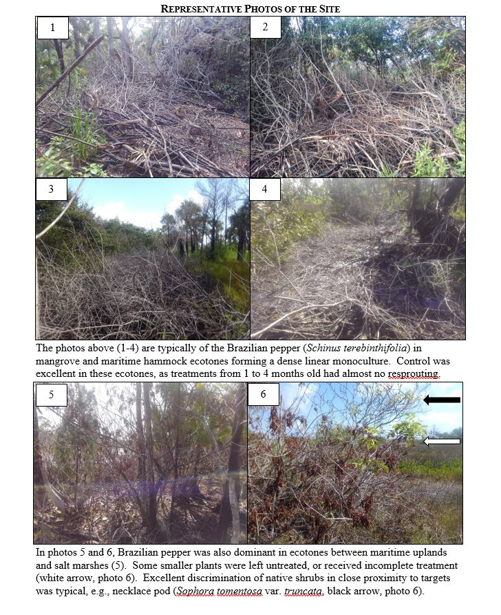
Post Treatment Monitoring
Investigate Tracks
Survey
Report
Form
Additional information page
Photos and Maps
Notes:
Our reports usually consist of photos with examples of what we found.

Slide 17
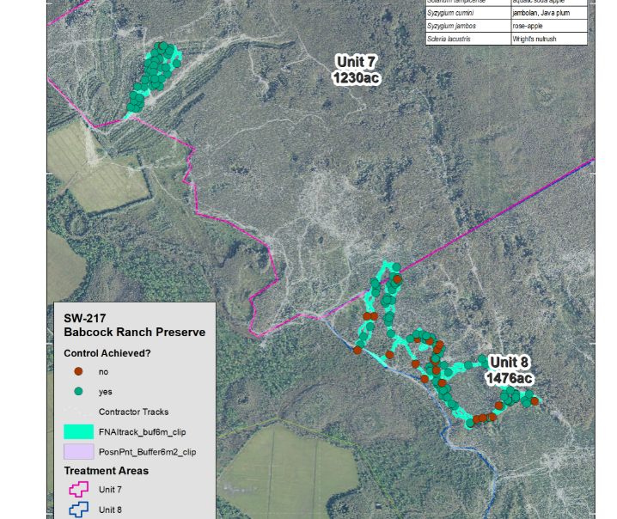
Post Treatment Monitoring
Investigate Tracks
Survey
Report
Form
Additional information page
Photos and Maps
Notes:
Including maps…

Slide 18
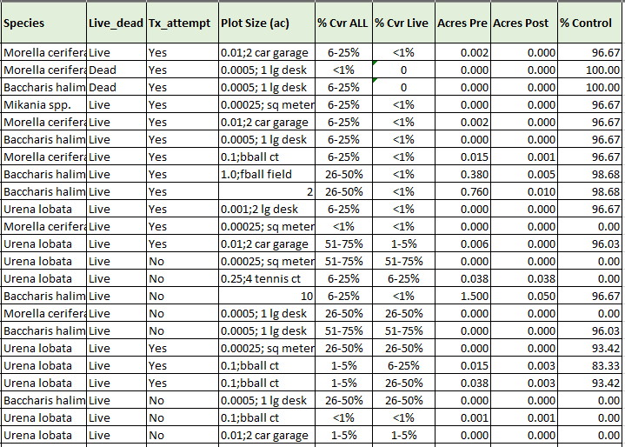
Post Treatment Monitoring
Investigate Tracks
Survey Area
Report
Data analysis
Notes:
And data tables…which we can produce acres of biomass reduction, infested acres (pre/post), and also help to inform managers what each point on the map means.

Slide 19
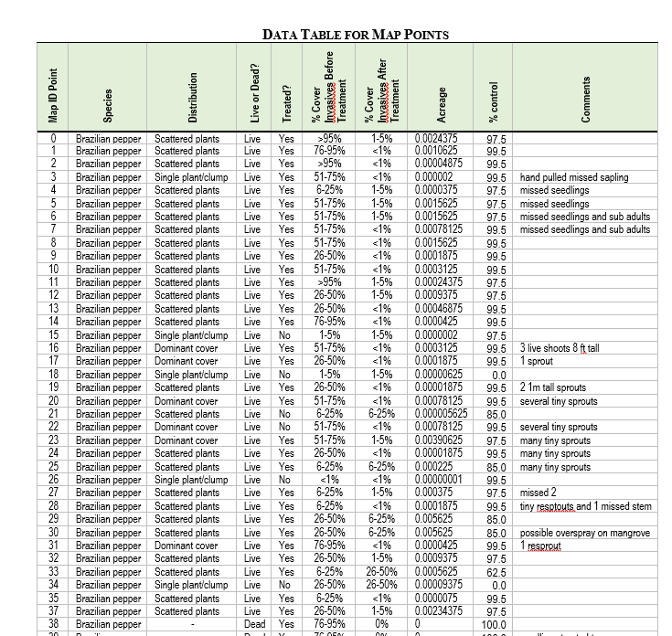

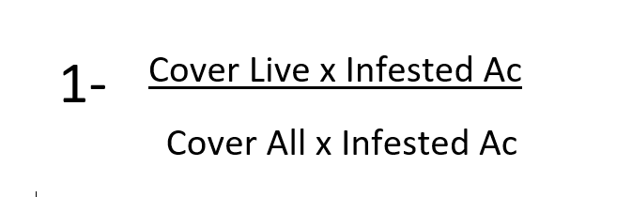
Post Treatment Monitoring
Investigate Tracks
Survey Area
Report
Data analysis
Notes:
And data tables…which we can produce acres of biomass reduction, infested acres (pre/post), and also help to inform managers what each point on the map means.

Slide 20
Example…
Cover Class | Mid-point
<1% | 0.005
1-5% | 0.030
5-25% | 0.150
25-50% | 0.375
50-75% | 0.625
75-95% | 0.850
>95% | 0.975
You find some Cogon..
1 ac
50-75% Cover class live + dead
25-50 live

Slide 21

Example…
You find some Cogon..
1 ac
50-75% Cover class live + dead
25-50 live

Slide 22






Example…
You find some Cogon..
1 ac
50-75% Cover class live + dead
25-50 live

Slide 23
Other examples of monitoring… 1.Can Help YOU prepare for next year. -map infestations -spend up front to save later 2.Can be integrated into long term monitoring plans. -You can set goals “reduce exotics cover by 50% in 5 years” 3.Can help you locate undetected species -Contact FNAI or others with botany expertise for EDRR/Rare plant surveys

Slide 24
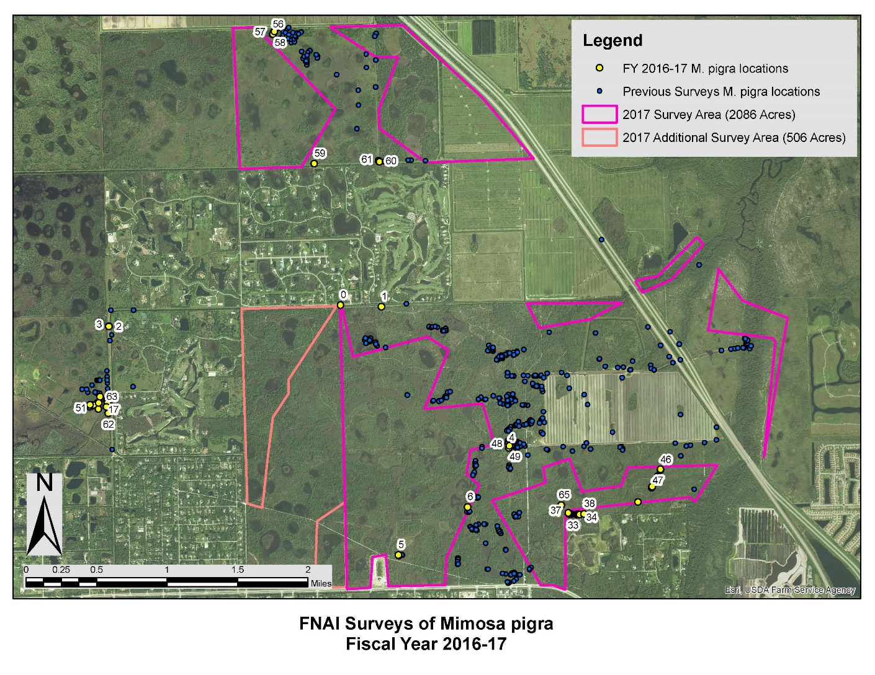
Mimosa pigra Surveys
Notes:
Here’s an example of an EDRR type survey. The findings are being used to guide treatments there and can be used to measure success.

Slide 25
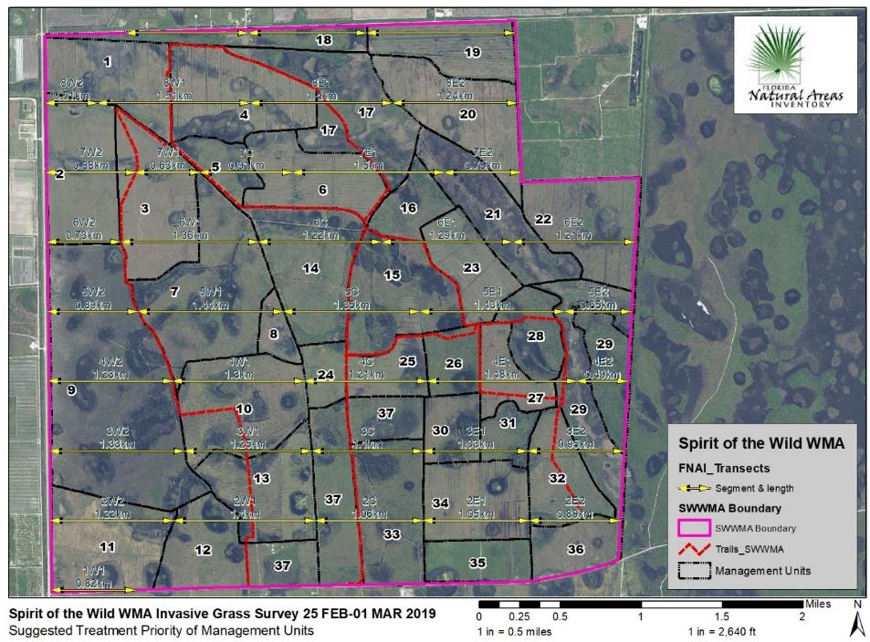
Exotic Grass Surveys
Notes:
Here’s an example of an EDRR type survey. The findings are being used to guide treatments there and can be used to measure success.

Slide 26
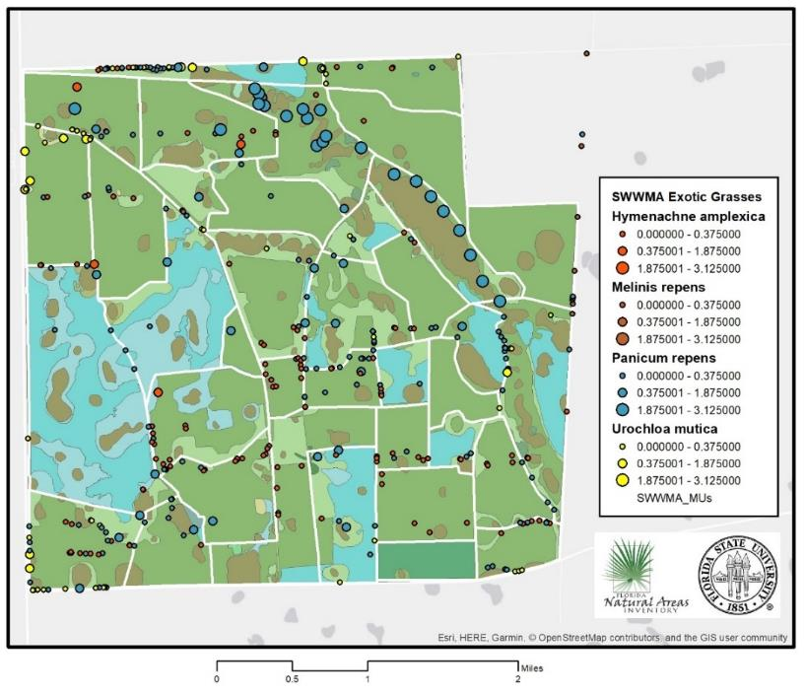
Exotic Grass Surveys- SWWMA
Notes:
Here’s an example of an EDRR type survey. The findings are being used to guide treatments there and can be used to measure success.

Slide 27
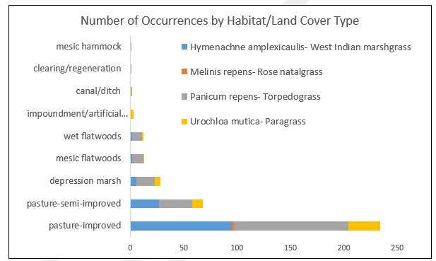
Exotic Grass Surveys
Notes:
Here’s an example of an EDRR type survey. The findings are being used to guide treatments there and can be used to measure success.

Slide 28
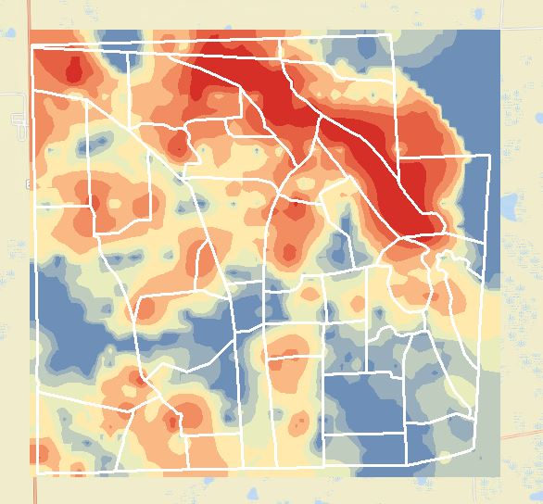
Exotic Grass Surveys
Notes:
Here’s an example of an EDRR type survey. The findings are being used to guide treatments there and can be used to measure success.

Slide 29
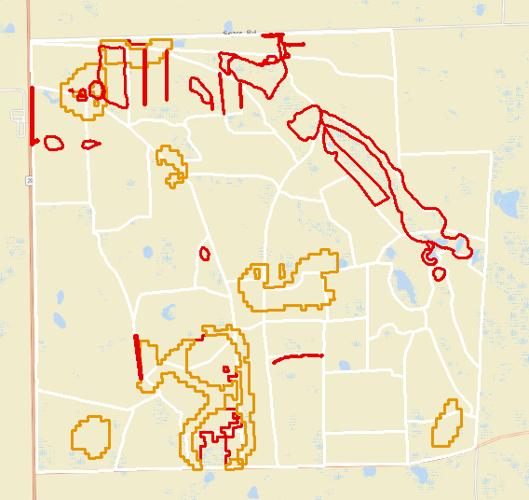
Exotic Grass Surveys
Notes:
Here’s an example of an EDRR type survey. The findings are being used to guide treatments there and can be used to measure success.

Slide 30
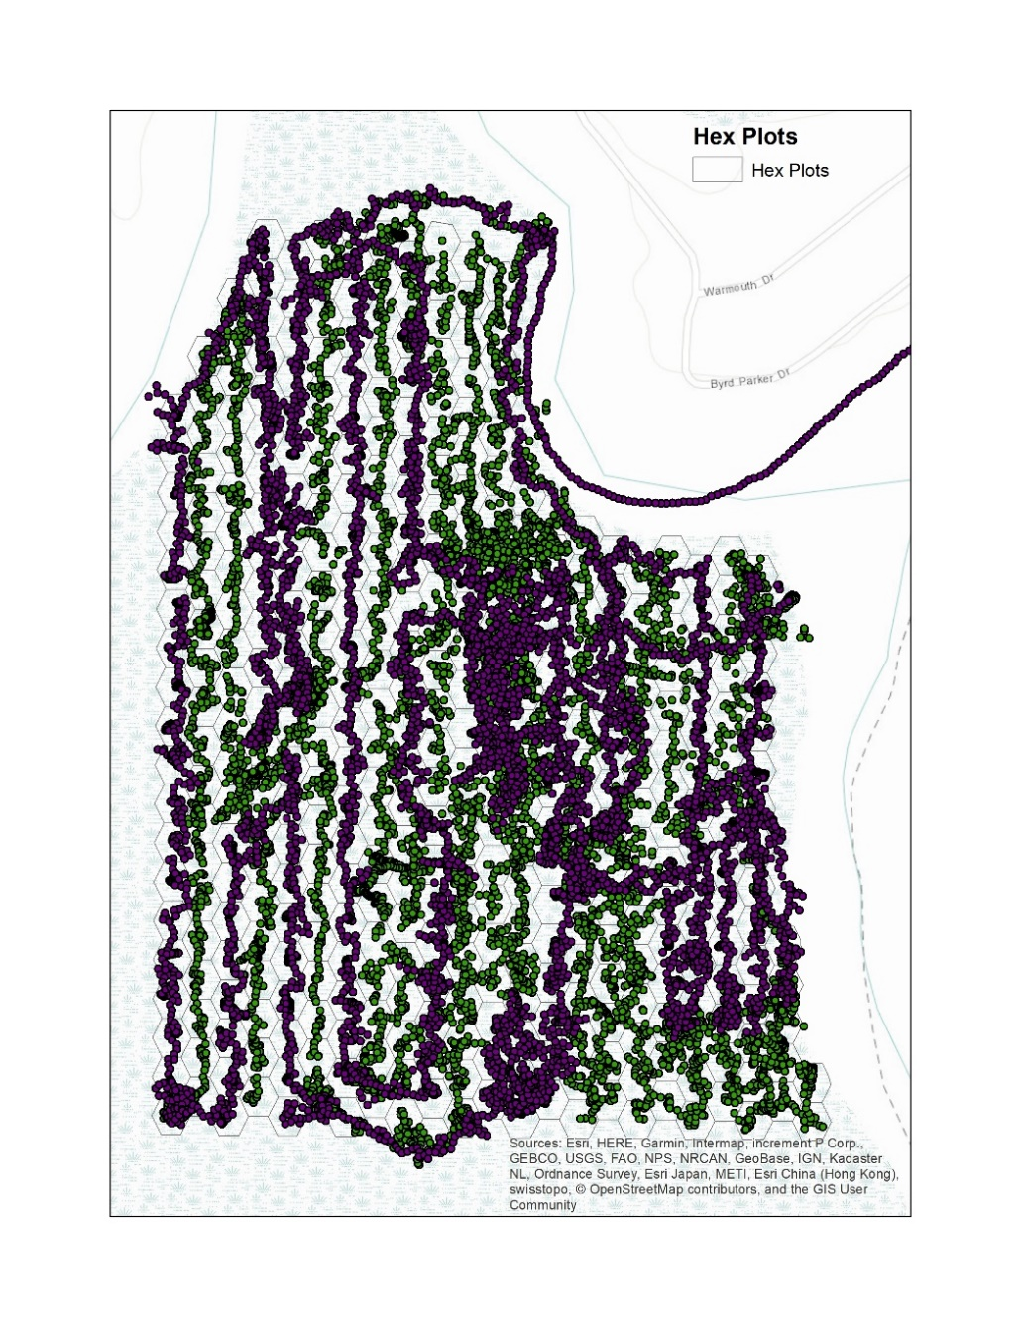
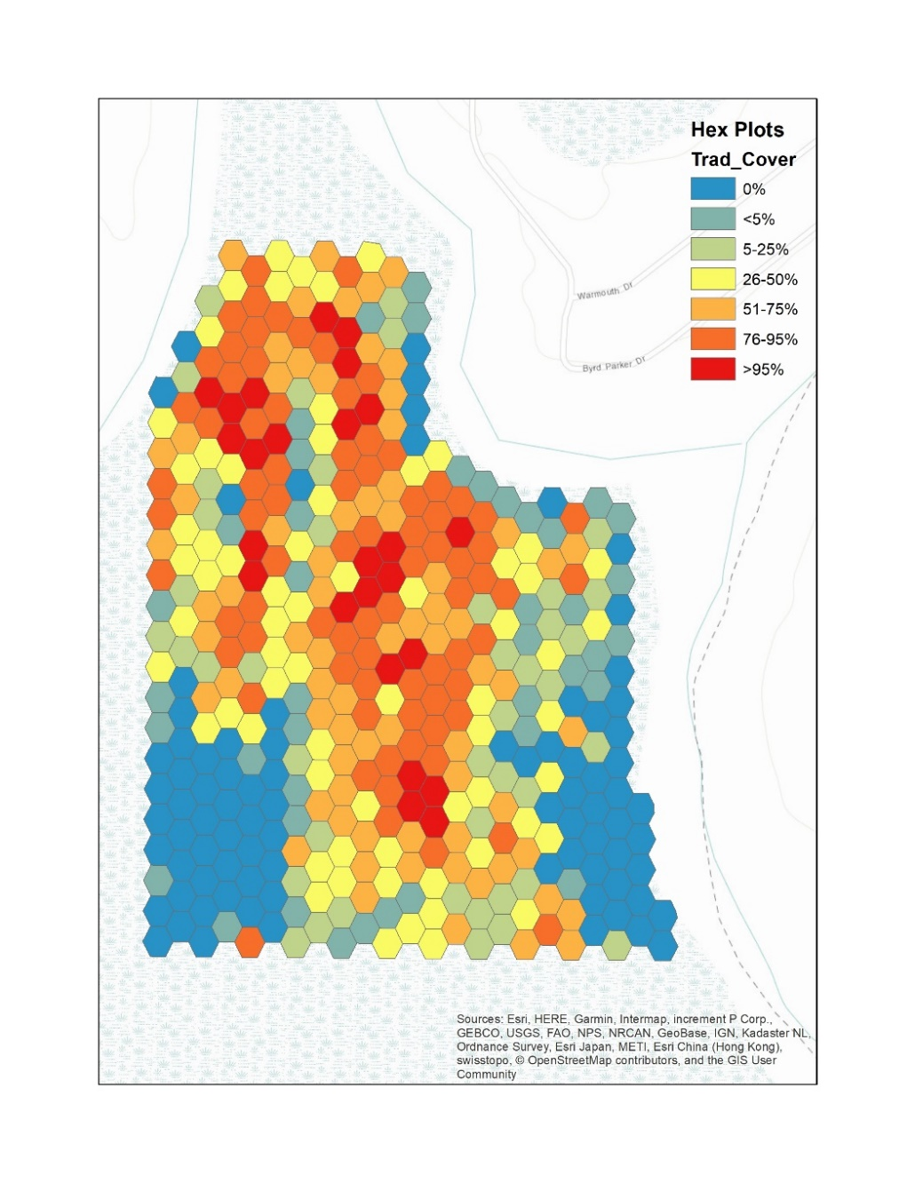
Tradescantia fluminensis Survey
Notes:
Here’s a more recent treatment effectiveness for Tradescanthia fluminensis survey we did again with FWC, you can see the tracks of the left. This was a rapid survey but allows for a nice visual assessment of the density and location of the plant

Slide 31
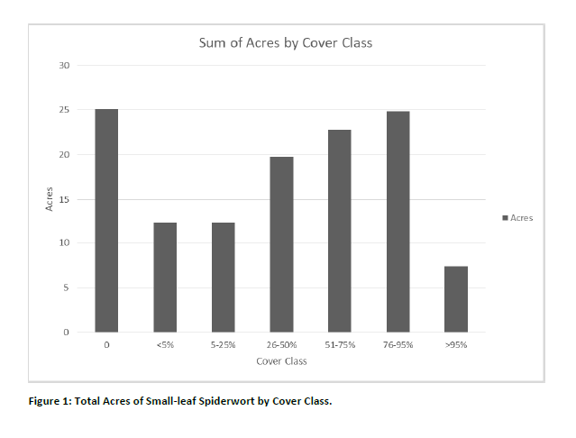
Notes:
Also acreage by cover class can be totaled and this is part of a before after study with FWC. So we will be seeing what the results are after our survey this spring.

Slide 32
Questions?
Visit us at: fnai.org
Email contact:
Chad Anderson
canderson@fnai.fsu.edu
Dexter Sowell
dsowell@fnai.fsu.edu
Frank Price
fprice@fnai.fsu.edu
Notes:
And with that, thank you for listening and to our partners and collaborations that make all this possible. I will be glad to answer any questions with the remaining time...

Slide 33
Example…
You find some Cogon..
1 ac
50-75% Cover class live + dead
25-50 live

Slide 34
Example…
You find some Cogon..
1 ac
50-75% Cover class live + dead
25-50 live

Slide 35
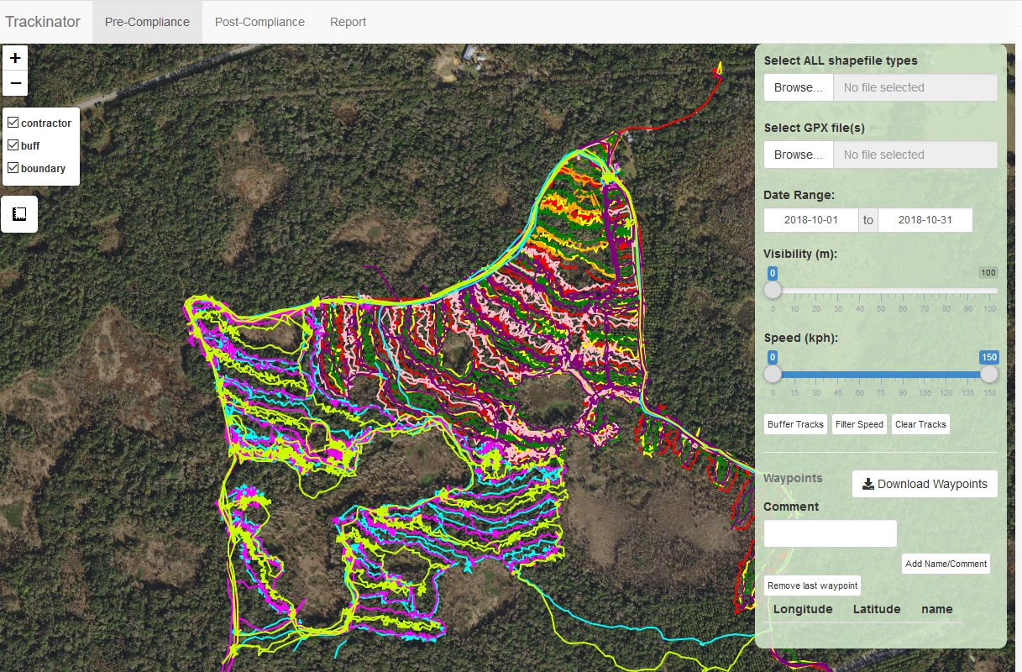
Trackinator Example

Slide 36
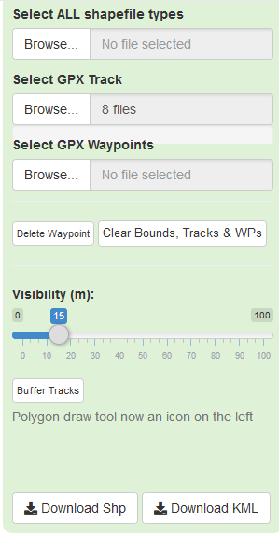
Trackinator Example

Slide 37
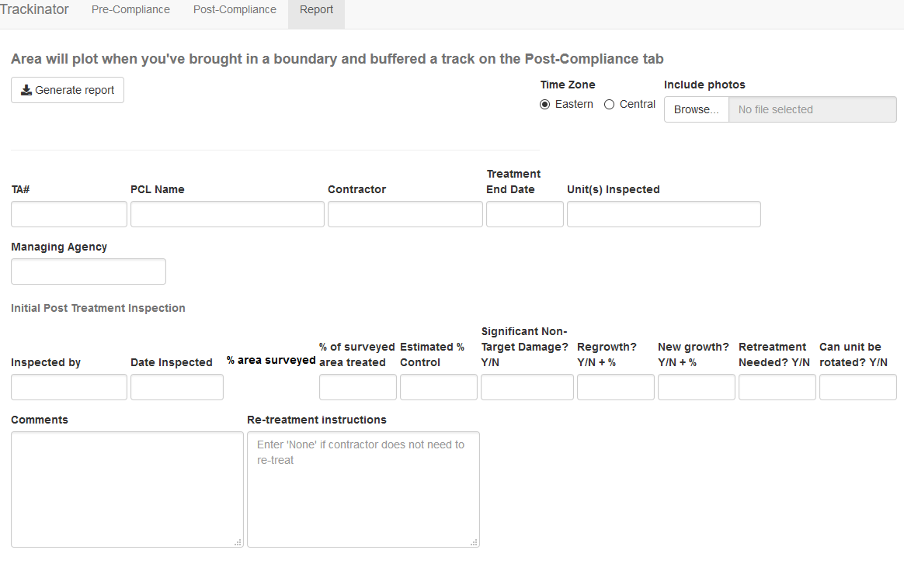
Trackinator Example

Slide 38
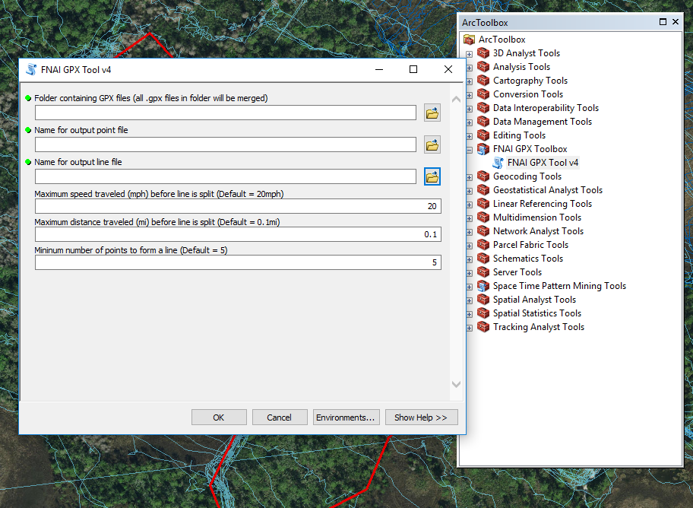
FNAI BUFFER TRACK TOOL

Slide 39
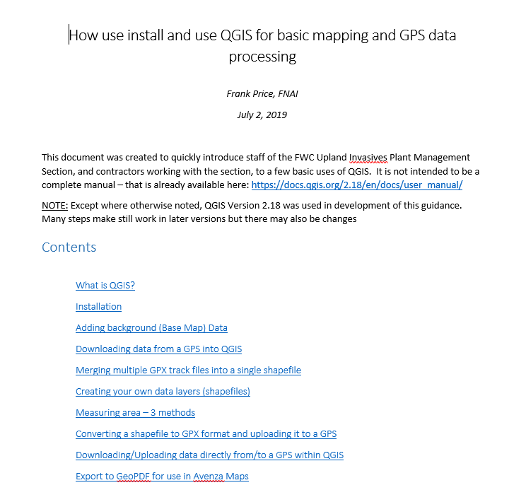
Q GIS TRAINING

Slide 40
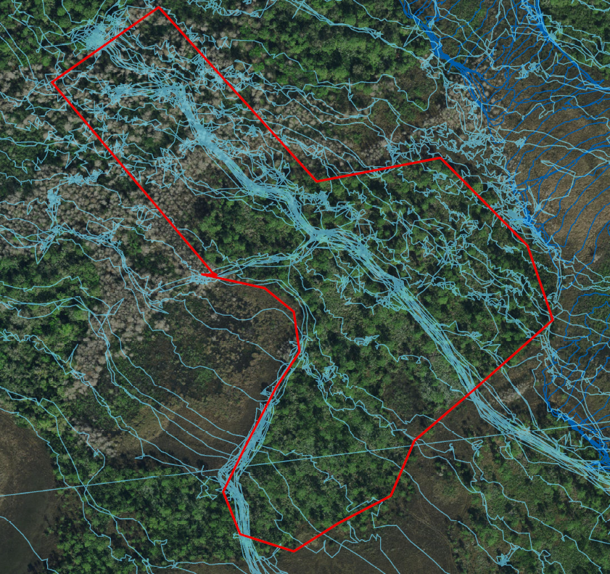
Field Exercise

Slide 41
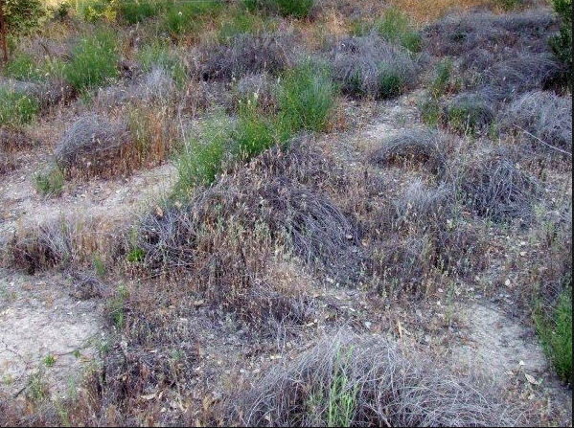
Characteristics to ID Plant affected by Herbicide

Slide 42
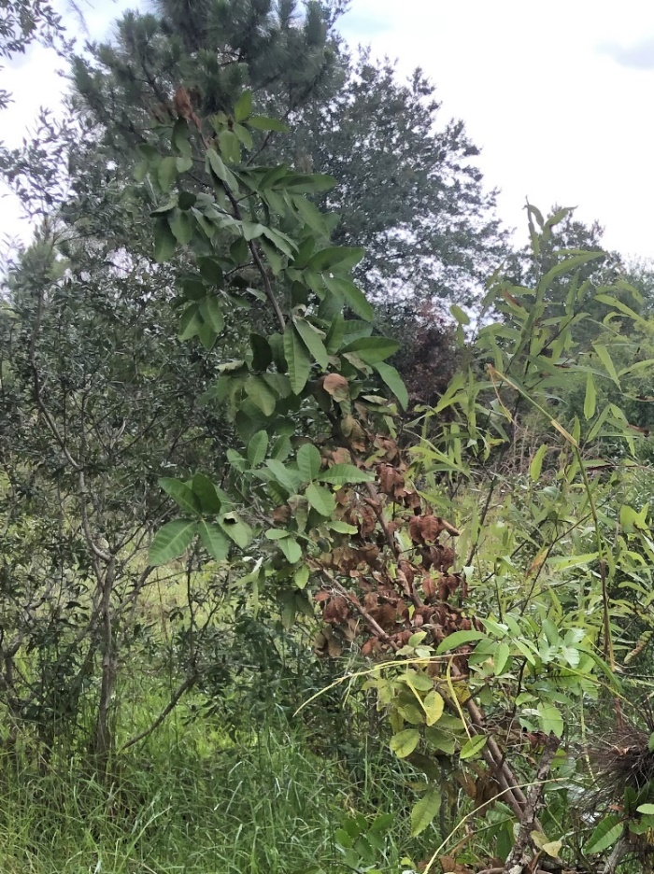
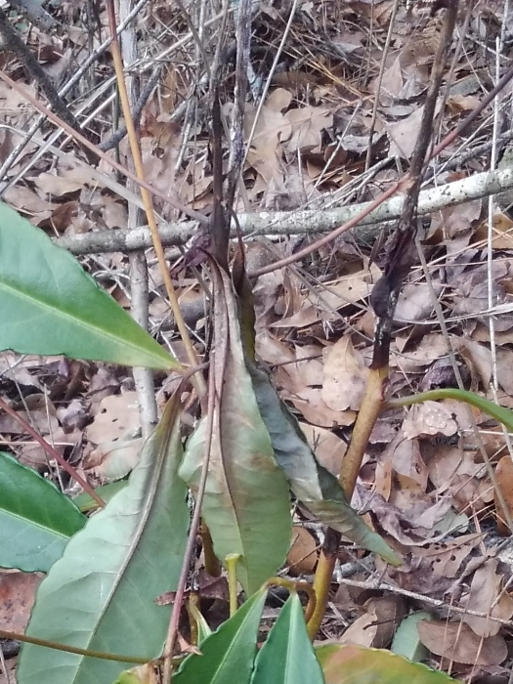
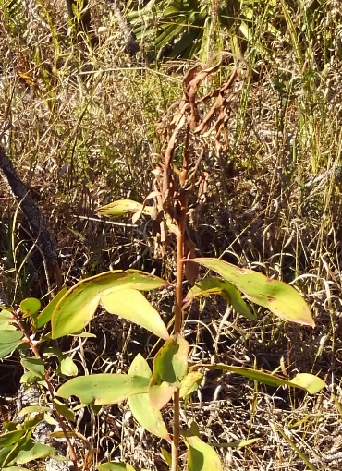
What are the stages of decline?
Newest growth (branch tip/twigs, newest leaves) die first
Time frames for each picture is Weeks After Treatment (WAT)
>11 WAT
>9.5 WAT
~2-4 WAT

Slide 43
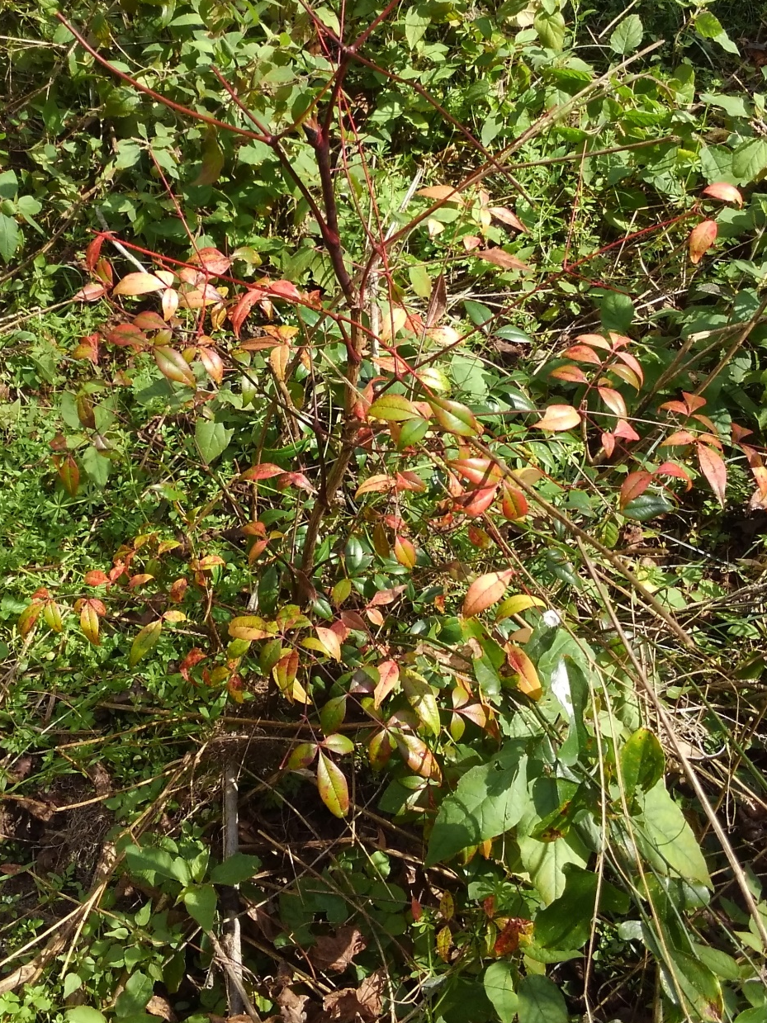
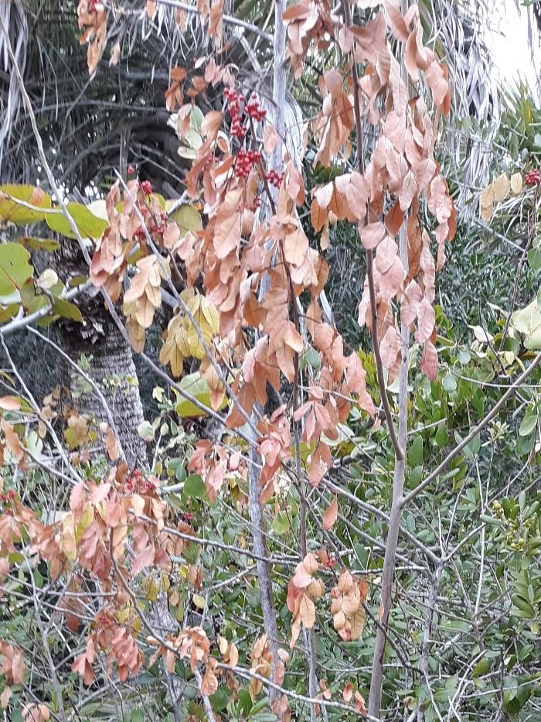
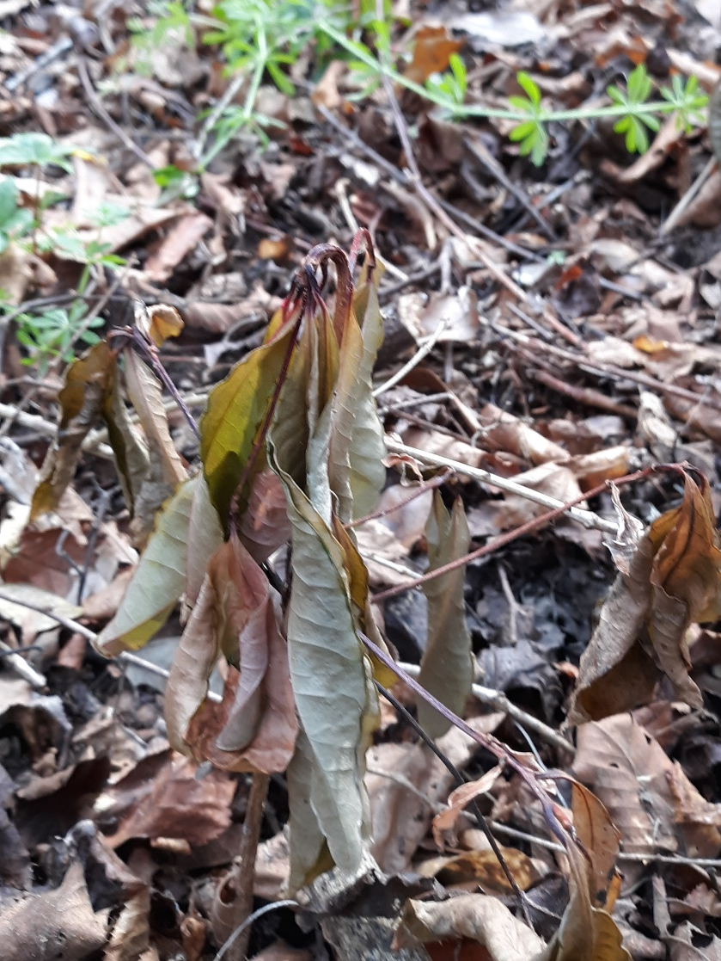
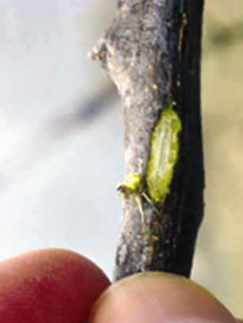
What are the stages of decline?
Newest growth (branch tip/twigs, newest leaves) die first
Other leaves begin to discolor (but still green tinted), may hold their shape; cambium green
>8.5 WAT
>11.5 WAT
>11.5 WAT
Notes:
Leaves discolored, but still greenish. Note cambium is still green beneath bark.

Slide 44
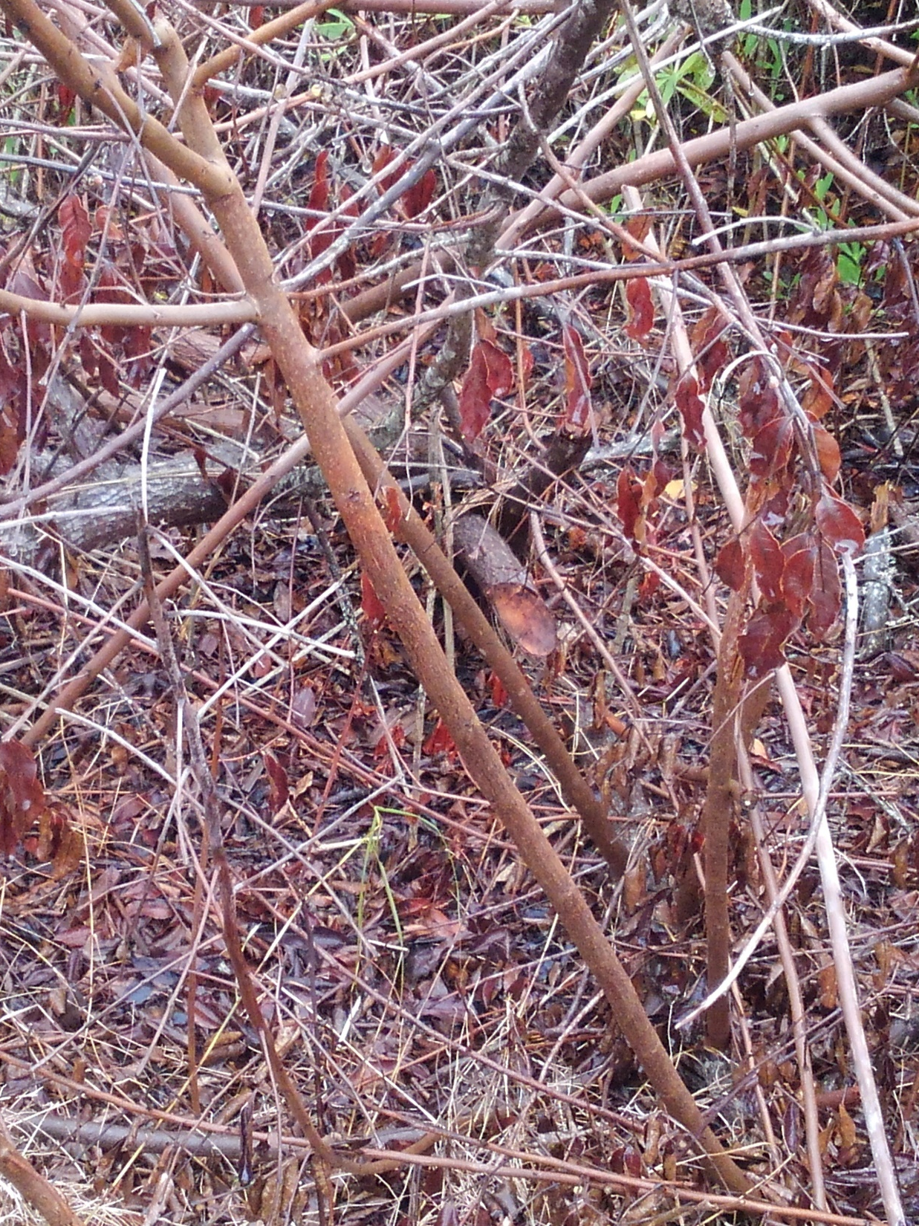
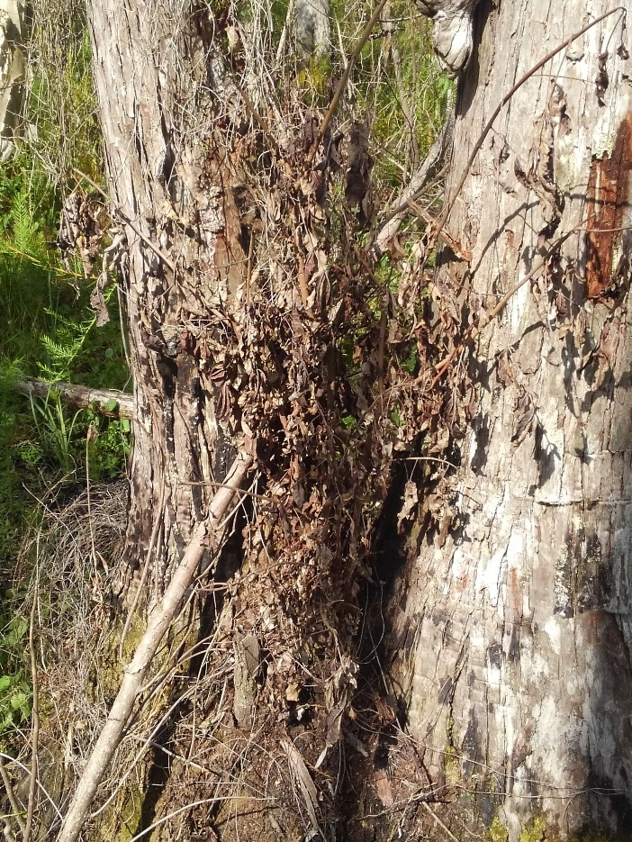
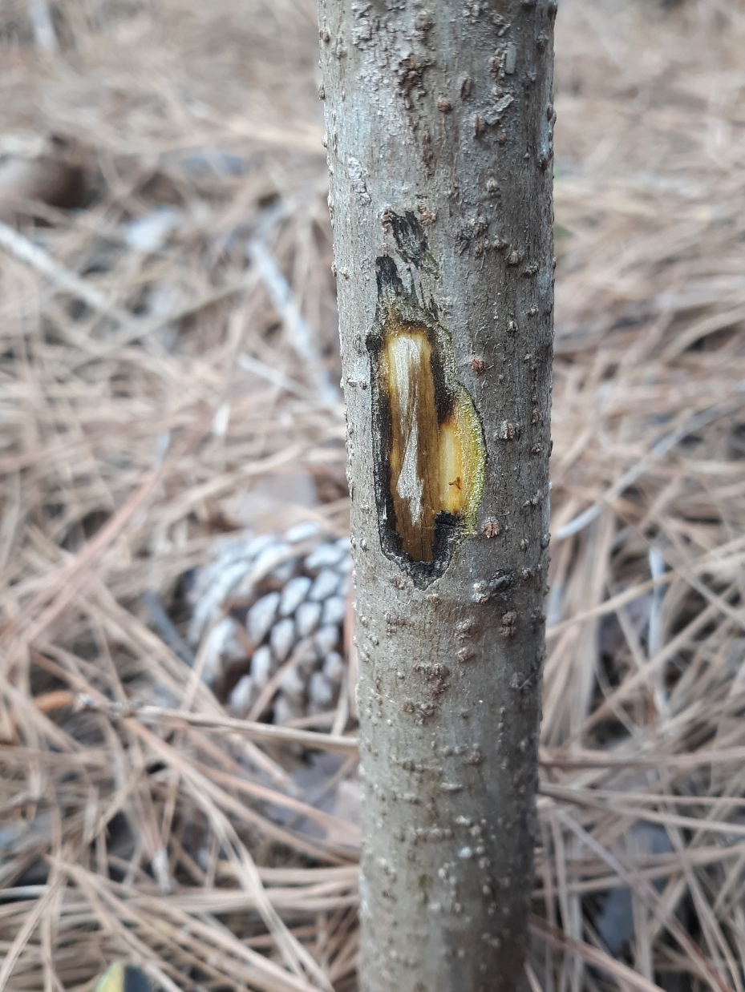
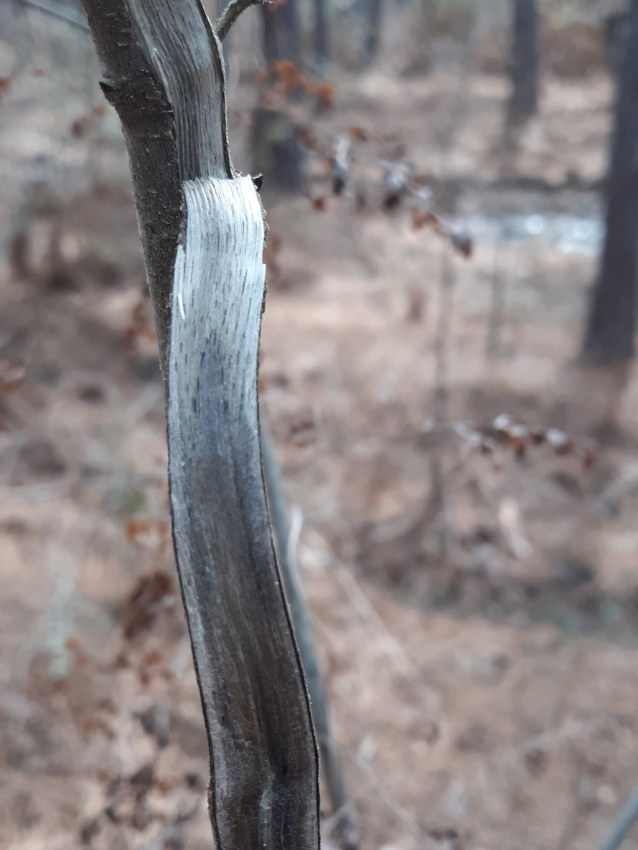
What are the stages of decline?
Newest growth (branch tip/twigs, newest leaves) die first
Other leaves begin to discolor (but still green tinted), may hold ‘shape’; cambium green
Leaves further discolored, loss of shape (droop, shrivel/warp); cambium discolored
Leaves brown, crispy; cambium dead and no longer green; leaves & fruits still present
>10.5 WAT
>11.5 WAT
>23.5 WAT
Notes:
Cambium now discolored.

Slide 45
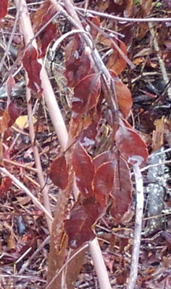
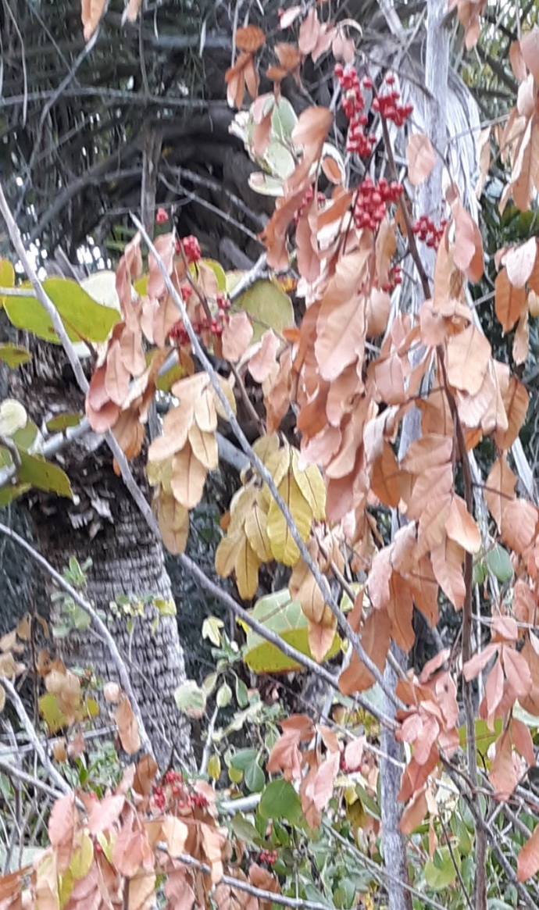
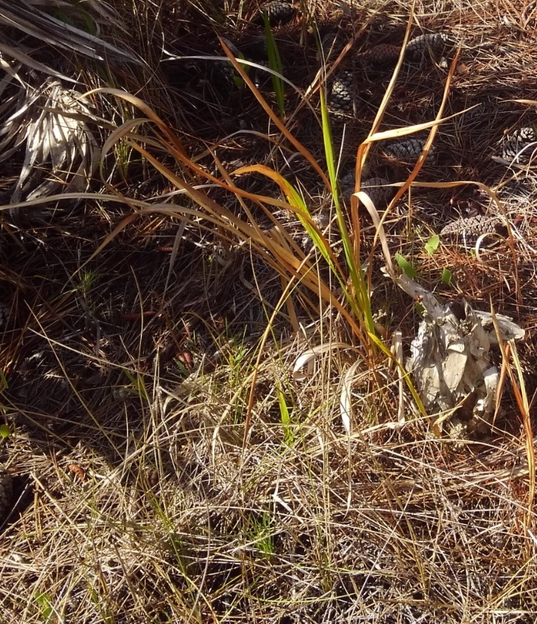
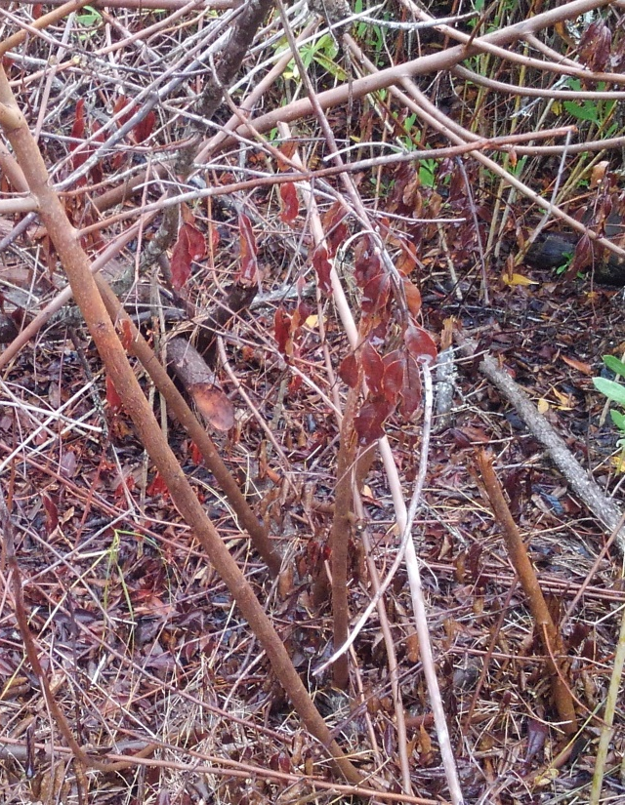

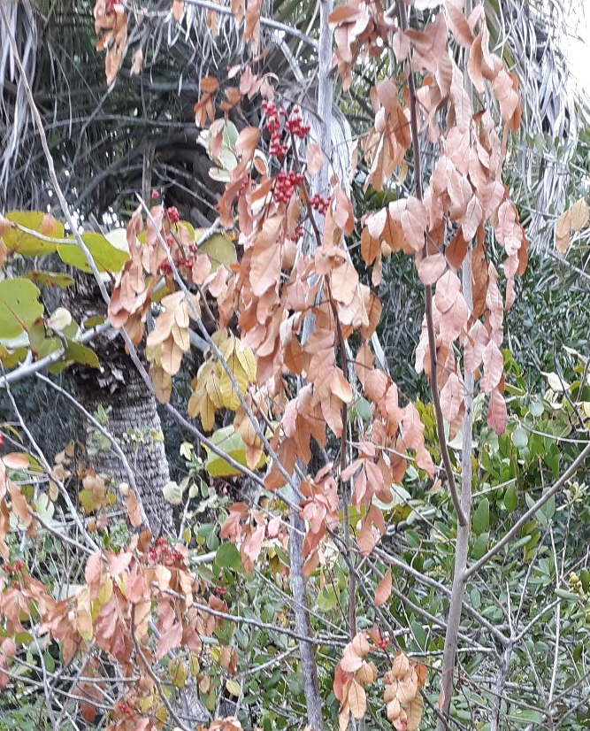
When to inspect?
Herbaceous vs. Woody species
Herbaceous species usually show good curing by 6-8 WAT
Woody species can show discolored or deformed leaves at 6 WAT
>10 WAT
>6.5 WAT
>10.5 WAT

Slide 46
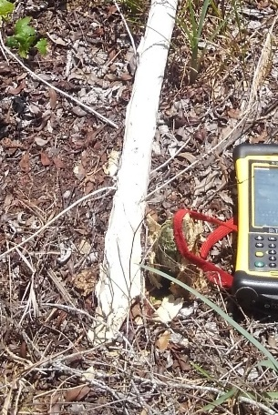
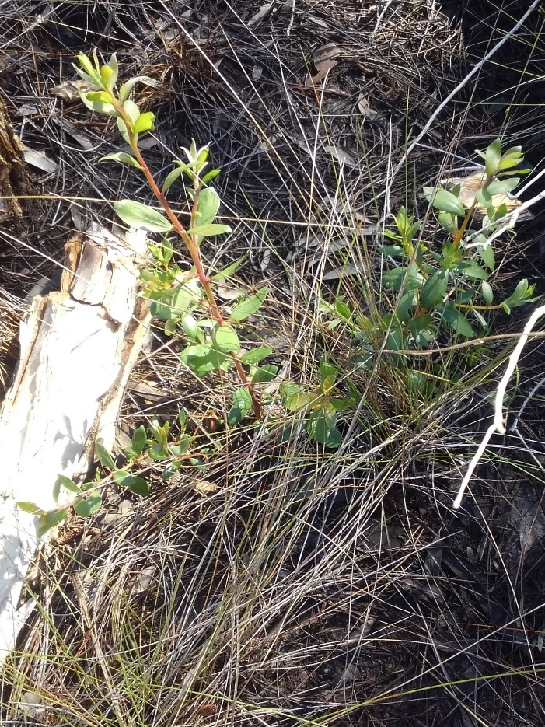


When to inspect?
Woody Species Treatments: cut-stump vs. hack-n-squirt & basal bark
Cut-stump has no ‘curing’ stage
Delay inspection to 10-12 WAT to allow for stump sprouting to be checked
>8.5 WAT
>9.5 WAT
>9.5 WAT
>17.5 WAT
Notes:
Note melaleuca treated at 8.5 WAT is controlled. MQ plant at 9.5 WAT was likely treated, but insufficiently, due to sprouting from base. Leadtree at 17.5 WAT was likely cut but not treated, i.e., had no herbicide applied to stem/cut stump; sprouting is vigorous.

Slide 47



When to inspect?
Woody Species Treatments: cut-stump vs. hack-n-squirt & basal bark
Hack-n-squirt and basal bark take time to cure (herbicide uptake into plant)
Delay inspection to 6-12 WAT: check for stump sprouts, defoliation/foliar curing
>11 WAT H-n-S
>6.5 WAT H-n-S
Notes:
1) No sprouting from hack-n-squirt with method (aminocyclopyrachlor). Cambium grew so fast that bark has popped off heartwood. 2) Much green in photo, but BP is mostly defoliated. Yellowed at left, and green at right.

Slide 48




When to inspect?
Woody Species Treatments: cut-stump vs. hack-n-squirt & basal bark
Hack-n-squirt and basal bark take time to cure (herbicide uptake into plant)
Delay inspection to 6-12 6-12 WAT: check for stump sprouts, defoliation/foliar curing
>6.5 WAT BB
>12 WAT BB
Notes:
1 & 2) Large BP is dead from 20% garlon 4 tx BB. Leaves are brown, drooping, crispy.
3 & 4) BP is dead from 15% garlon 4 BB tx. Plants completely cured already.

Slide 49





When to inspect?
Exceptions: active vs. slow metabolic rates
Some species take up herbicide slowly
Tuberous sword fern (Nephrolepis cordifolia) in shade vs. sun
Can inspect 6 WAT: check for treatment coverage, not control
Control may be 3-6 months away.
>7 WAT
>7 WAT
>11 WAT

Slide 50




When to inspect?
Exceptions: active vs. slow metabolic rates
Some species take up herbicide slowly
Coral ardisia (Ardisia crenata)
Timing of inspection: Inspect as if treatment were Cut Stump/H-n-S/Basal bark (6-12 WAT)
Check for treatment coverage, not control efficacy. Control may be 3-6 months away.
>11.5 WAT

Slide 51




When to inspect?
Exceptions: active vs. slow metabolic rates
Some species take up herbicide slowly
Coral ardisia (Ardisia crenata)
Timing of inspection: Inspect as if treatment were Cut Stump/H-n-S/Basal bark (6-12 WAT)
Check for treatment coverage, not control efficacy. Control may be 3-6 months away.
>11 WAT

Slide 52






Climbing ferns
Differentiate Recent vs. Past treatment
Recent Tx: vines are brown and extremely strong, some leaflets usually still attached
Past Tx: vines are gray, vines may have some strength or be brittle, no leaflets present
>4.5 WAT
>52 WAT
>9.5 WAT
>17.5 WAT

Slide 53


Sub-lethal effects of herbicide on plants
Irregular leaf growth
>11 WAT H-n-S
>9.5 WAT C-S
Notes:
1 & 2) H-n-S of Camphor tree with garlon 4 16.6% (or glyphosate/milestone 2/0.078%). Leaves irregular, enrolled. 3) Diminutive leaves of downy rose-myrtle due to C-S triclopyr acid (Trycera) 25%.

Slide 54

Impact of Inundation on Target Control
G. MacDonald and S. Yuan
Notes:
Note addition of impazapyr will help improve control when biomass is below waterline.

Slide 55

Treatment Interval Based on Target Control
G. MacDonald and S. Yuan

Slide 56

Expected Target Control
Courtesy J. Glueckert
Notes:
ProcellaCOR EC is florpyrauxifen-benzyl; RU3 is glyphosate 3%

Slide 57
Post Treatment Monitoring…
Notes:
I want to switch gears and talk a bit about our post treatment monitoring. We do this primarily for FWC, but done it for other agencies. This can be done as a training or as a survey for you.

Slide 58
Show of Hands…
Tell us about your program
Describe your exotic plant monitoring?

