Slide 1
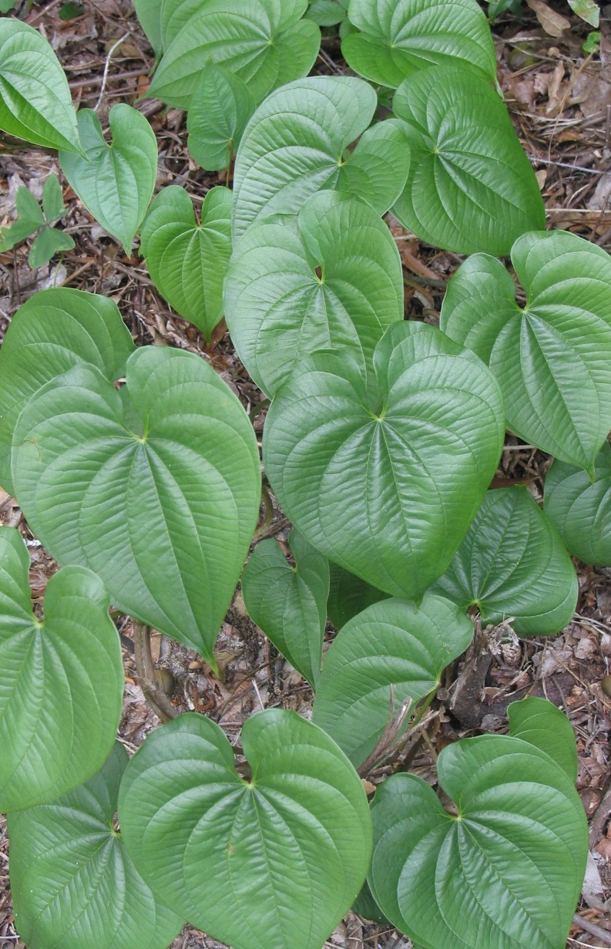

Key features in determining the weeds from the natives
Dexter Sowell & Kim Alexander
Florida Natural Areas Inventory

Slide 2
Introduction
Land managers and contractors
Active exotics removal in Florida and at same time high number of native/rare species that are very similar to exotics
Avoiding non-target damage to our natives is KEY
This presentation is a series of species comparisons to help us avoid non-target damage
Information Sources:
Florida Natural Areas Inventory
ISB Atlas of Florida Plants
UF/IFAS Center for Invasive Plants
EXOTIC
NATIVE
Don’t let “mistaken identity” happen in your invasives control projects !!!
Notes:
As most of you know and as Greg highlighted, Florida has an active invasive removal programs as well as many native species that resemble the species we are controlling.
Its vital that we do not harm our natives in the process of trying to free our landscapes of invasive species, especially because of mistaken identity.
For the remainder of this workshop we will go through examples of native invasive species look-a-likes and hopefully give you some good advice on how to distinguish them.
We were especially interested in highlighting vegetative characters since as you all know, plants are most often not in flower.
Most of these examples were sent in to us by people around the state
Sometimes even though from a distance two species look very similar, a few relatively easy to identify characters can help distinguishing look-a-likes.
Throughout the rest of this presentation, the exotic species will always be on the left hand side of the slide with its name in RED and the native on the right with name in green

Slide 3
TREES AND SHRUBS

Slide 4
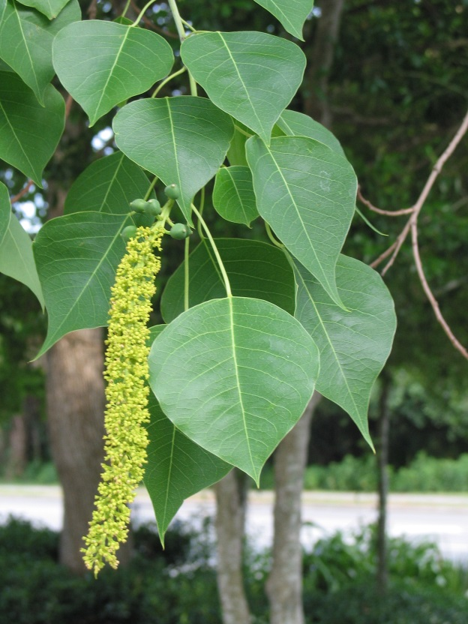
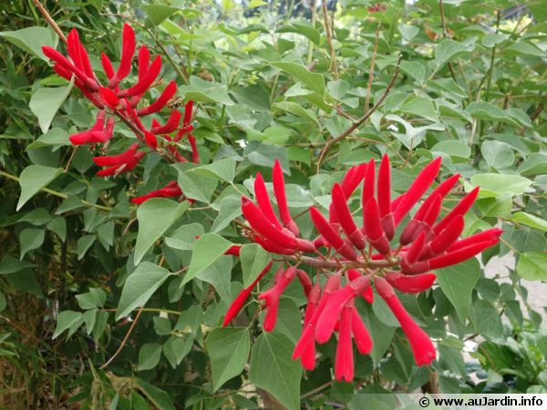
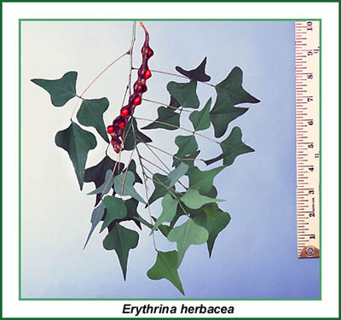
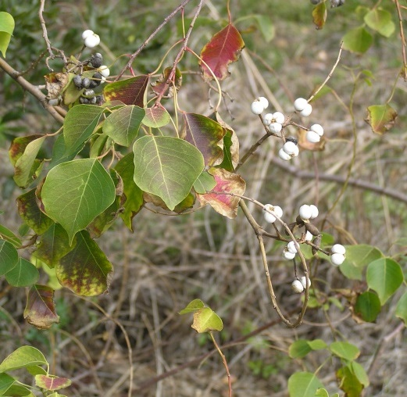
CHINESE TALLOW
Triadica sebifera
CORALBEAN
Erythrina herbacea
UF/IFAS
Notes:
Similarity – both have a long acuminate leaf apex

Slide 5
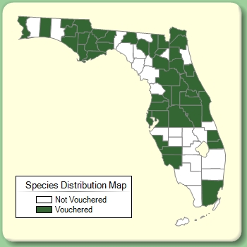
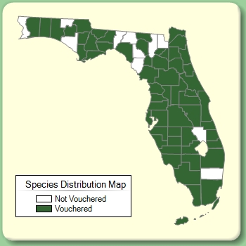
CHINESE TALLOW
Triadica sebifera
CORALBEAN
Erythrina herbacea
Tree, unarmed
Simple leaf
Small yellow flowers
Milky sap
Capsule with white seeds
Small shrub, armed
Compound leaf
Red tubular flower
No milky sap
Legume (bean pod) with red seeds

Slide 6
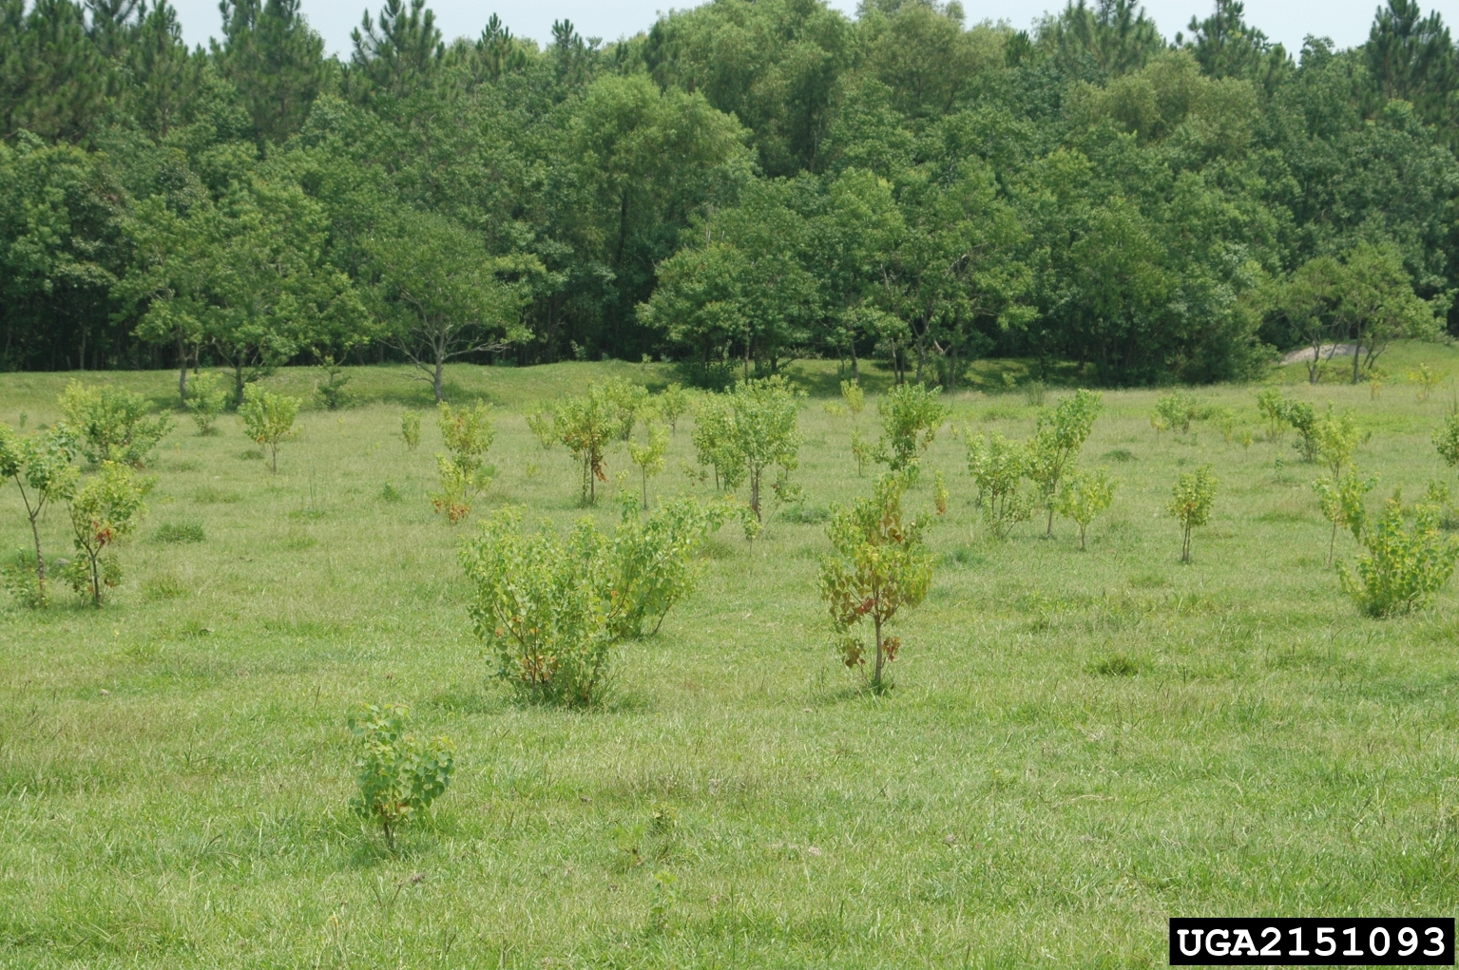
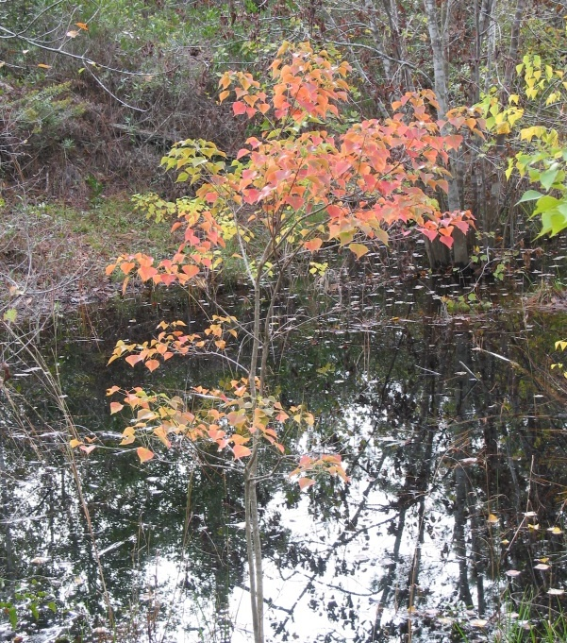
Notes:
Classic pasture invaded by young chinese tallow
Picture of the fall foliage, fall is the best time to survey for tallow, as its color is very distinct.

Slide 7
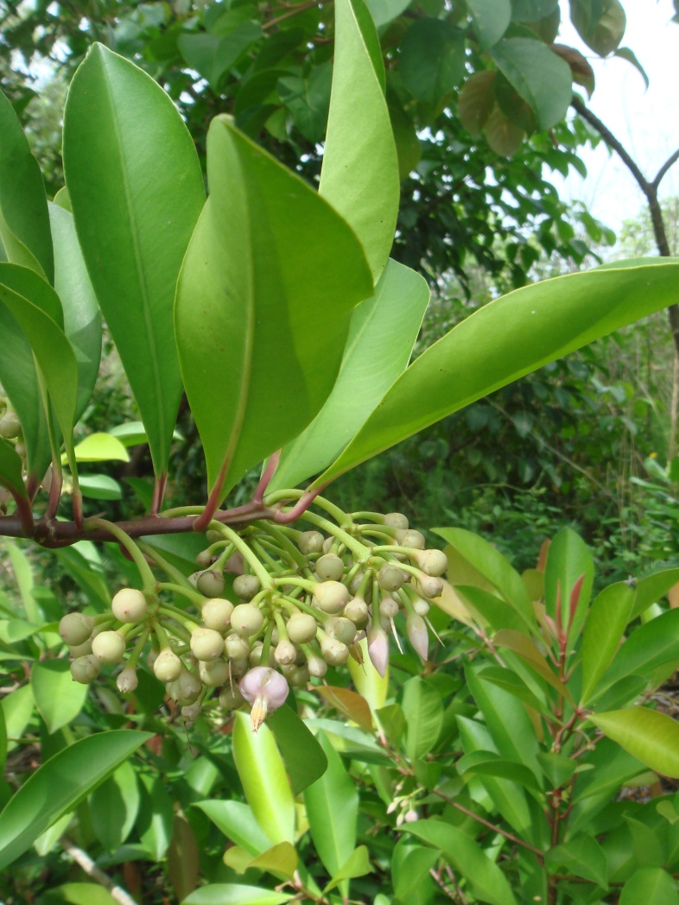
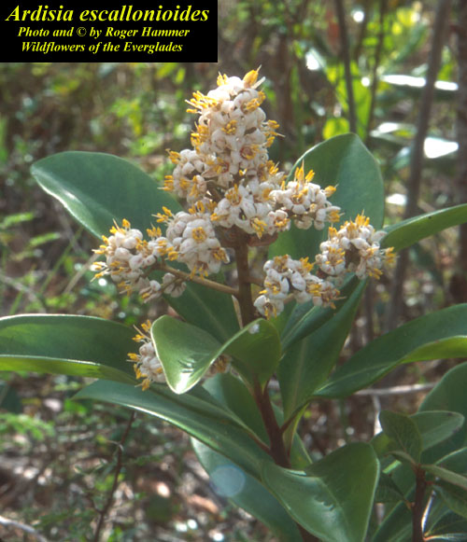
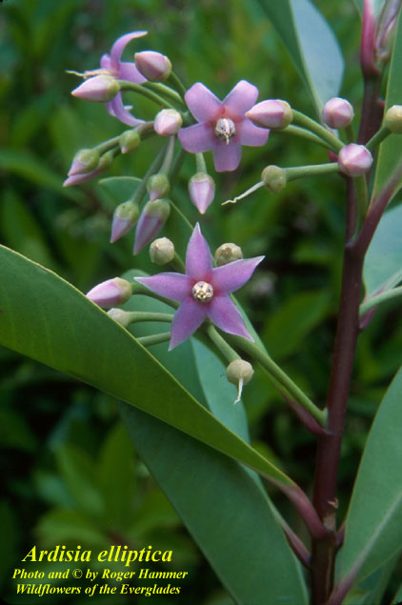
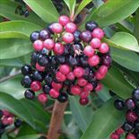
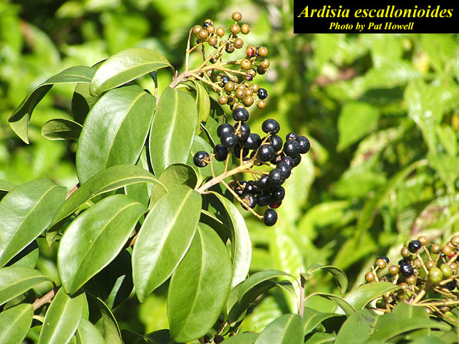
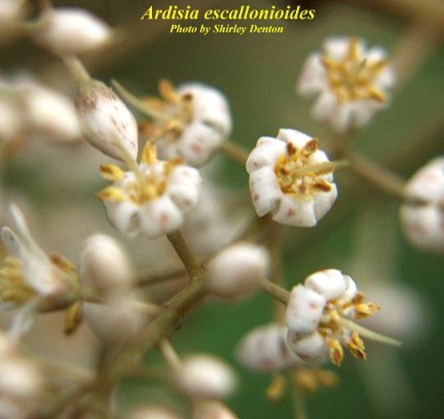
SHOEBUTTON ARDISIA
Ardisia elliptica
MARLBERRY
Ardisia escallonioides

Slide 8
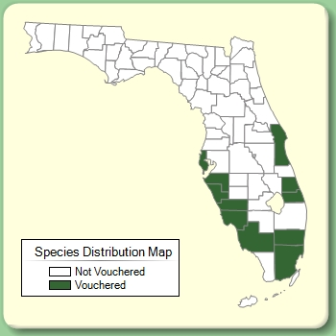
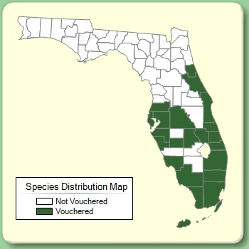
SHOEBUTTON ARDISIA
Ardisia elliptica
MARLBERRY
Ardisia escallonioides
Leaf margins revolute
Flowers in stalked axillary clusters
Shrub <2 meters tall
Leaf margins flat
Flowers in terminal clusters
Shrub/small tree to 5 meters tall or more

Slide 9
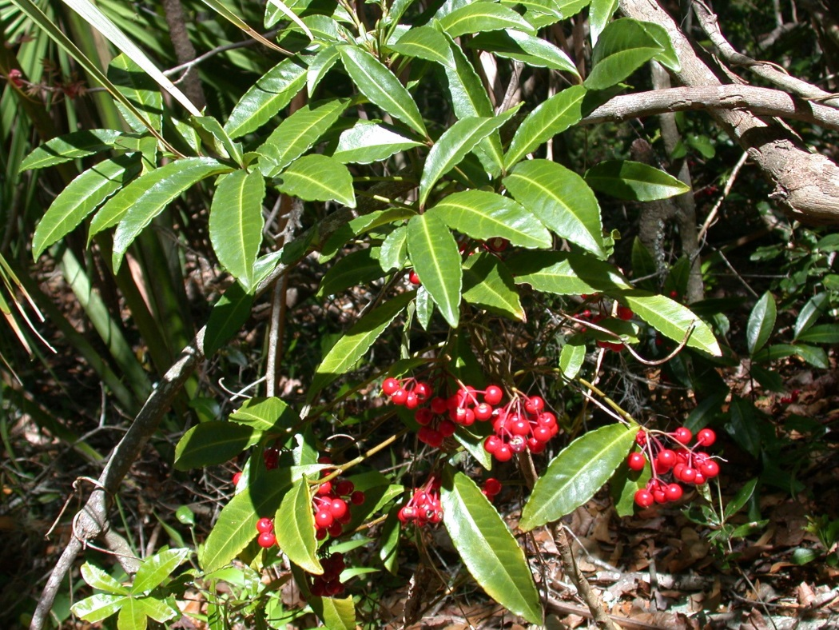
CORAL ARDISIA
Ardisia crenata
MARLBERRY
Ardisia escallonioides
Notes:
Similarity – leaves are a similar shape, both alternate. Similar fruits. Same genus. Both have lines and dots in leaf (looking through leaf with light behind)

Slide 10
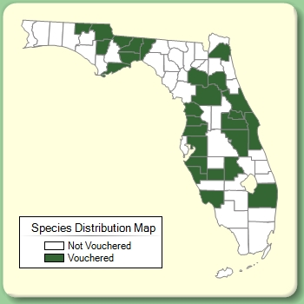
CORAL ARDISIA
Ardisia crenata
MARLBERRY
Ardisia escallonioides
Leaves with crenate margins
Flowers in stalked axillary clusters
Bright red drupes
Leaves entire
Flowers in terminal clusters
Drupes turning black

Slide 11
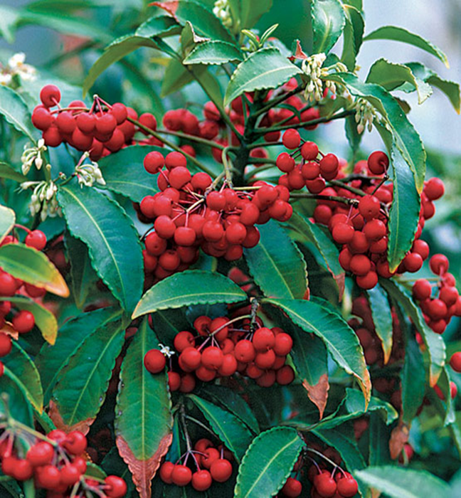
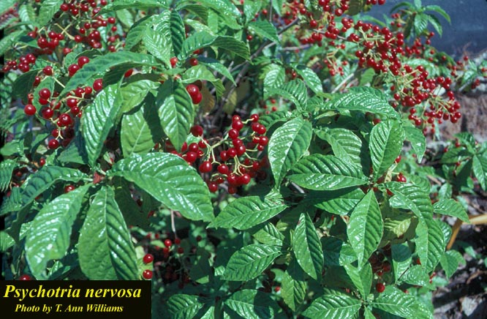
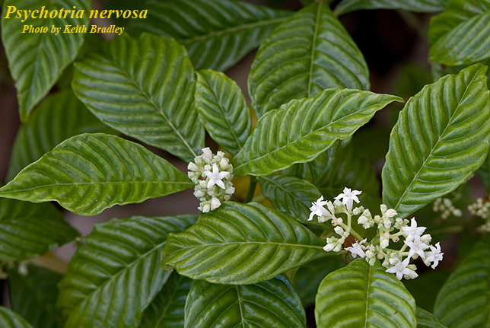
CORAL ARDISIA
Ardisia crenata
WILD COFFEE
Psychotria nervosa
Notes:
Similarity – red fruits, leaves and plants are similar size

Slide 12

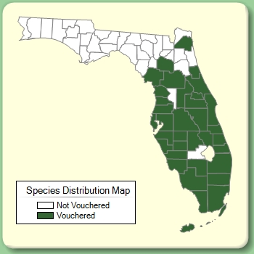
CORAL ARDISIA
Ardisia crenata
WILD COFFEE
Psychotria nervosa
Alternate leaves
Revolute, crenate leaf margin
Leaf veins not prominent
Opposite leaves
Slightly revolute, entire to wavy leaf margin
Leaf veins prominent

Slide 13
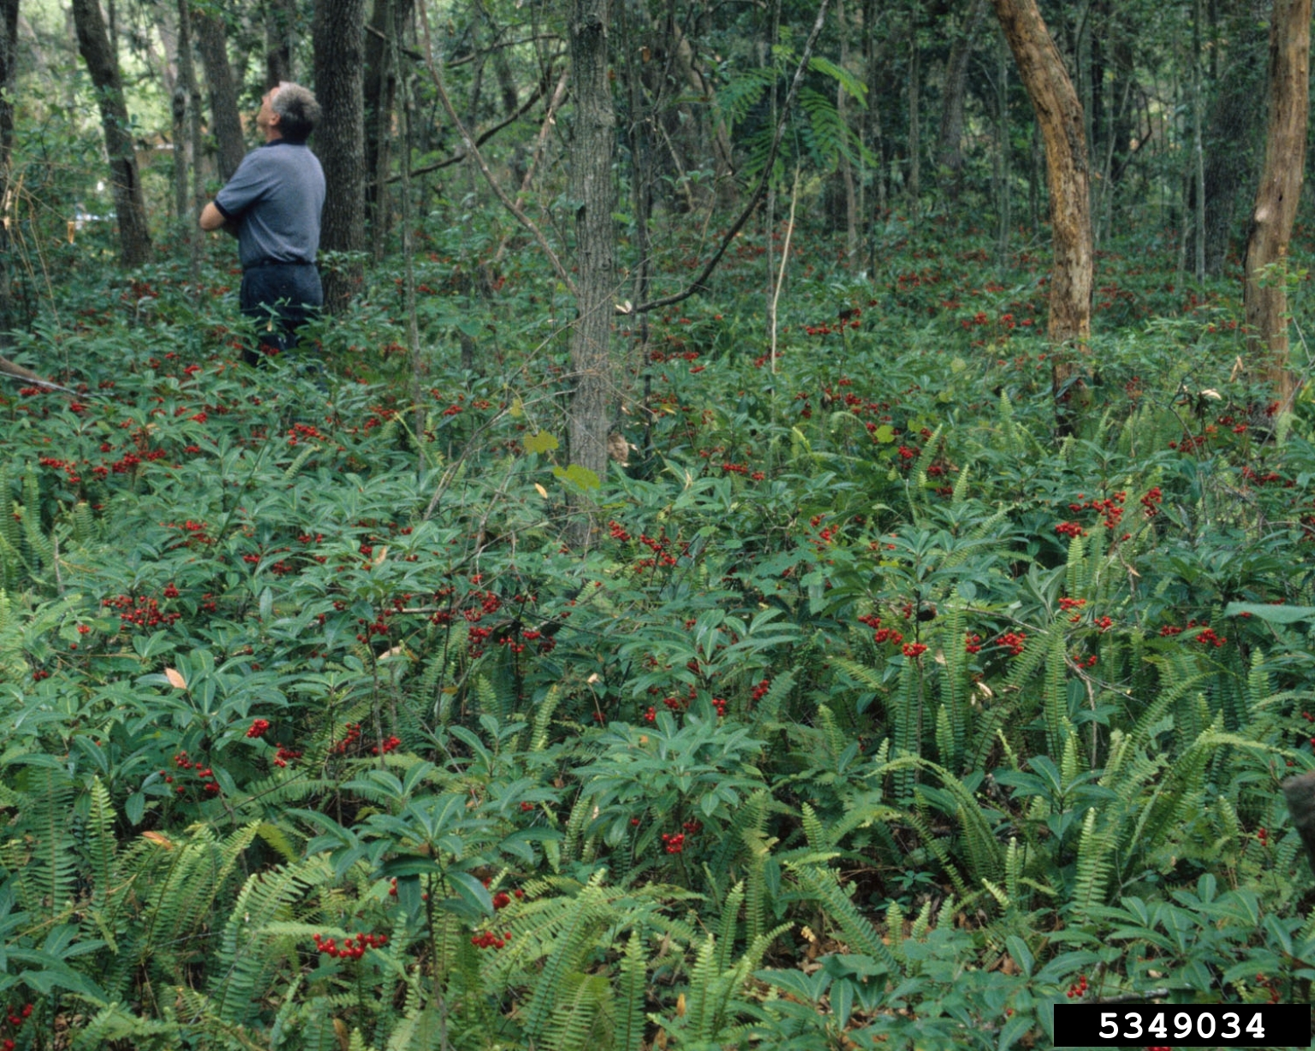
Notes:
A good look at the classic Coral Ardisia invasion, you would likely never see wild coffee, marlberry, or red buckeye in this density.

Slide 14
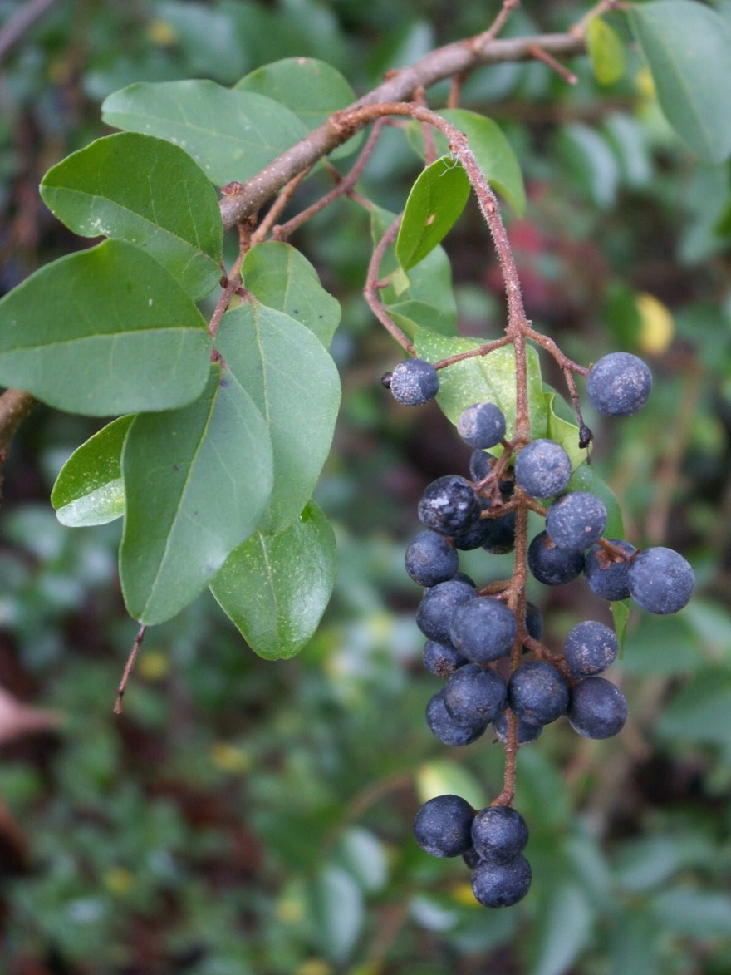
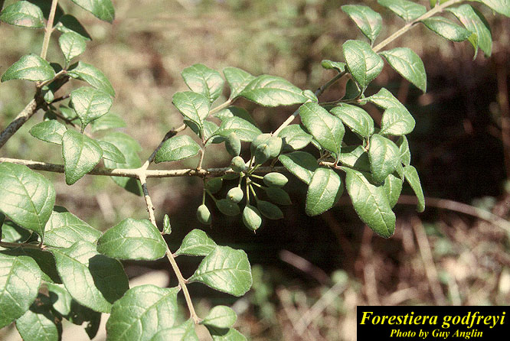
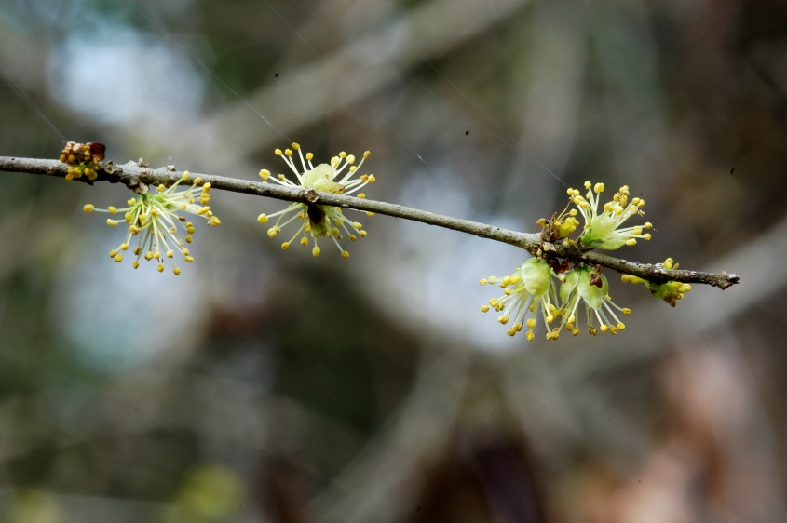
CHINESE PRIVET
Ligustrum sinense
GODFREY’S SWAMPPRIVET
Forestiera godfreyi
Notes:
Both have small opposite leaves, same family, fruits are blue/black at maturity, twigs and leaf stalks hairy

Slide 15
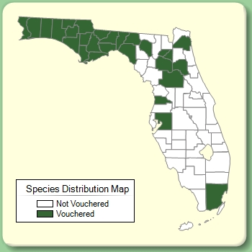
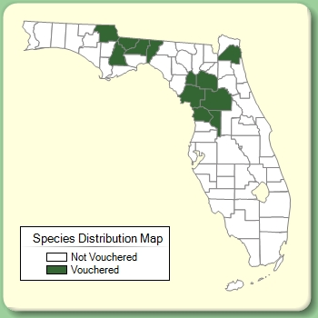
CHINESE PRIVET
Ligustrum sinense
GODFREY’S SWAMPPRIVET
Forestiera godfreyi
Terminal flower clusters
Evergreen leaves
Leaf margins entire
Short petiole
Underside of leaves with hairs along the midvein
Axillary flower clusters
Deciduous leaves
Leaf margins toothed above the middle
Longer petiole
Underside of leaves uniformly hairy

Slide 16
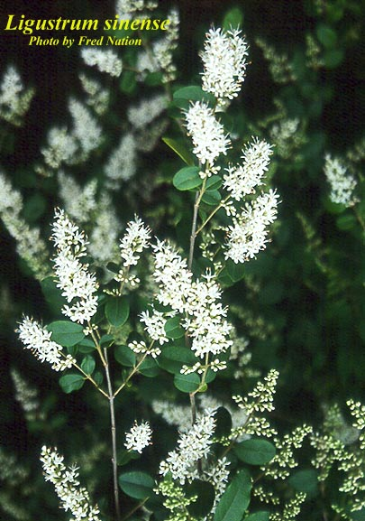
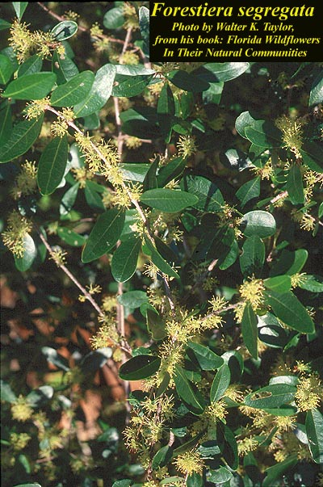
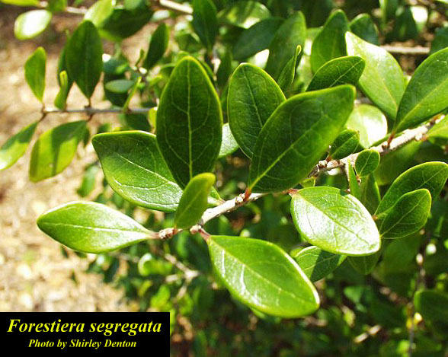
CHINESE PRIVET
Ligustrum sinense
FLORIDA SWAMPPRIVET
Forestiera segregata
Notes:
Both have small opposite leaves, both evergreen, same family, fruits are blue/black at maturity, twigs and leaf stalks hairy,

Slide 17
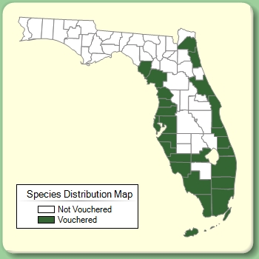
CHINESE PRIVET
Ligustrum sinense
FLORIDA SWAMPPRIVET
Forestiera segregata
Terminal flower clusters
Short petiole
Leaves elliptic
Underside of leaves with hairs along the midvein
Axillary flower clusters
Leaves sessile
Leaves obovate
Underside of leaves glabrous

Slide 18
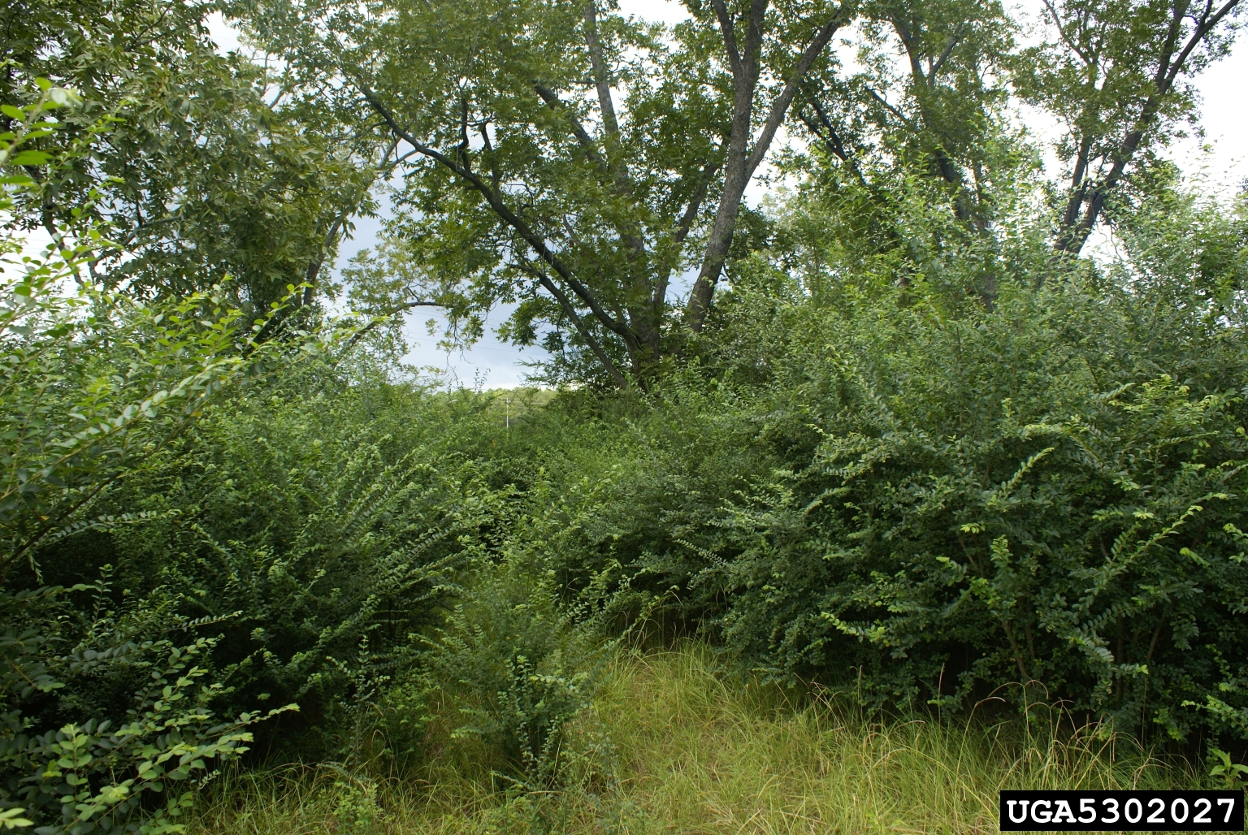
CHINESE PRIVET
Ligustrum sinense

Slide 19
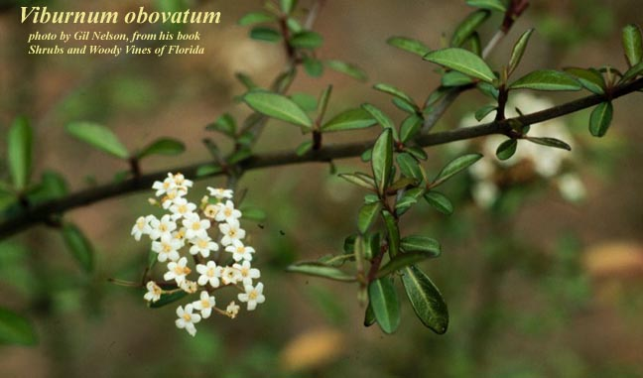
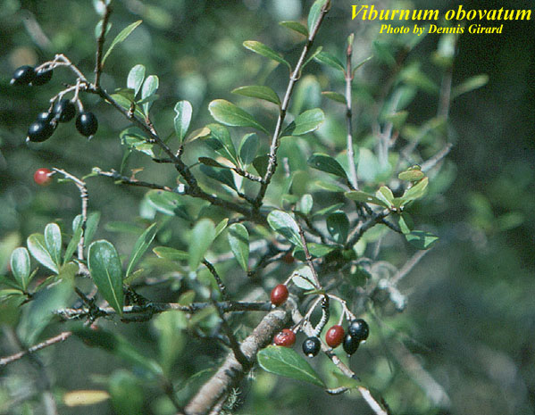
CHINESE PRIVET
Ligustrum sinense
WALTER’S VIBURNUM
Viburnum obovatum
Notes:
Both with opposite leaves, similar shape, white flowers, blue/black drupe

Slide 20
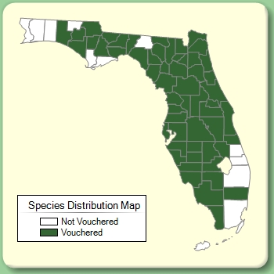
CHINESE PRIVET
Ligustrum sinense
WALTER’S VIBURNUM
Viburnum obovatum
Four petals/flower
Leaf margin entire
No short shoots
Young stems hairy
Five petals/flower
Leaf margin entire or serrate
Short shoots
Young stems and leaves with rusty scales

Slide 21
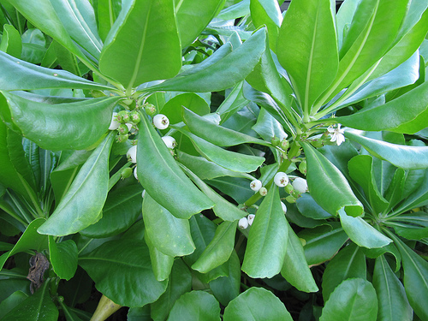
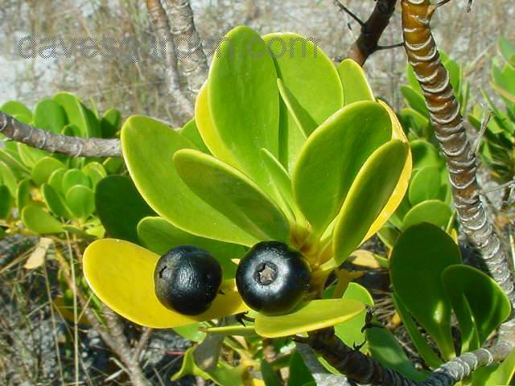
BEACH NAUPAKA
Scaevola taccada
INKBERRY
Scaevola plumieri
Notes:
Same genus, same habitat and growth form, leaves alternate, but closely

Slide 22
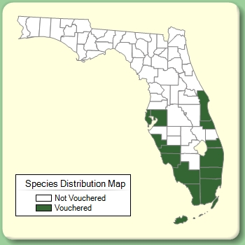
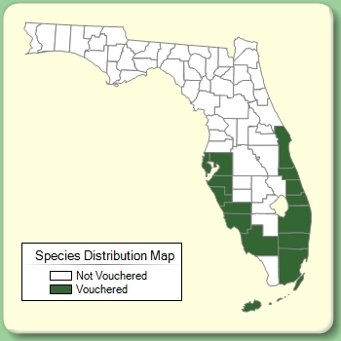
BEACH NAUPAKA
Scaevola taccada
INKBERRY
Scaevola plumieri
Leaves longer (to 21 cm)
Leaves rolled
Leaves less succulent
White fruit
Green foliage
Leaves shorter (to 10 cm)
Leaves flat
Leaves more succulent
Black fruit
Yellow-green foliage

Slide 23
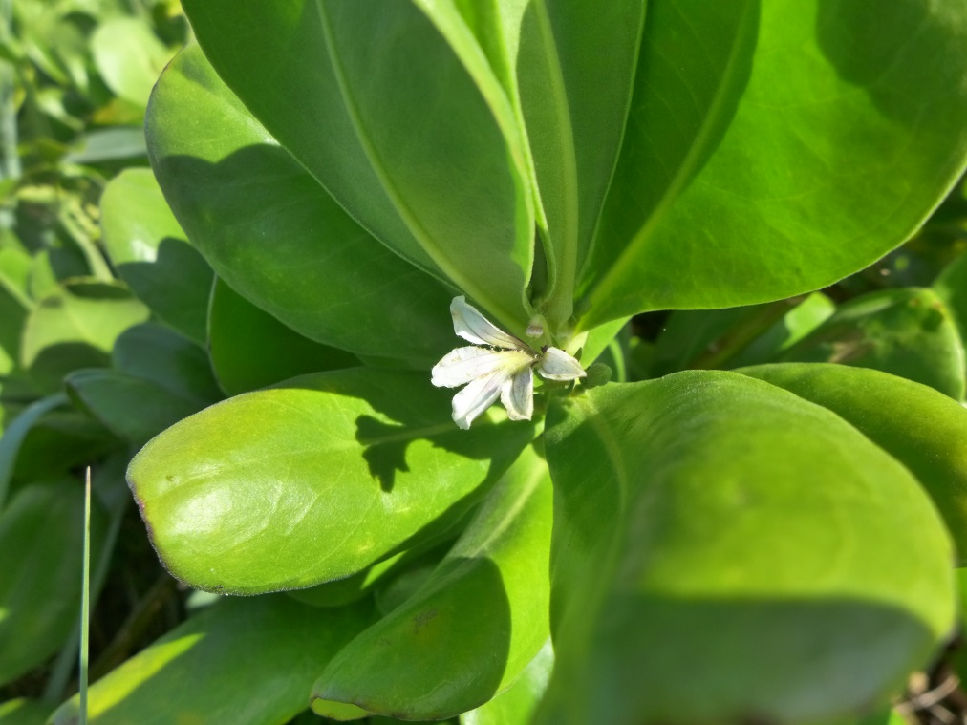
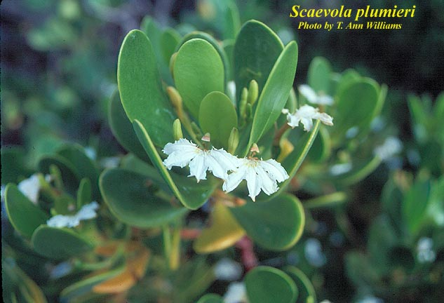
BEACH NAUPAKA
Scaevola taccada
INKBERRY
Scaevola plumieri

Slide 24
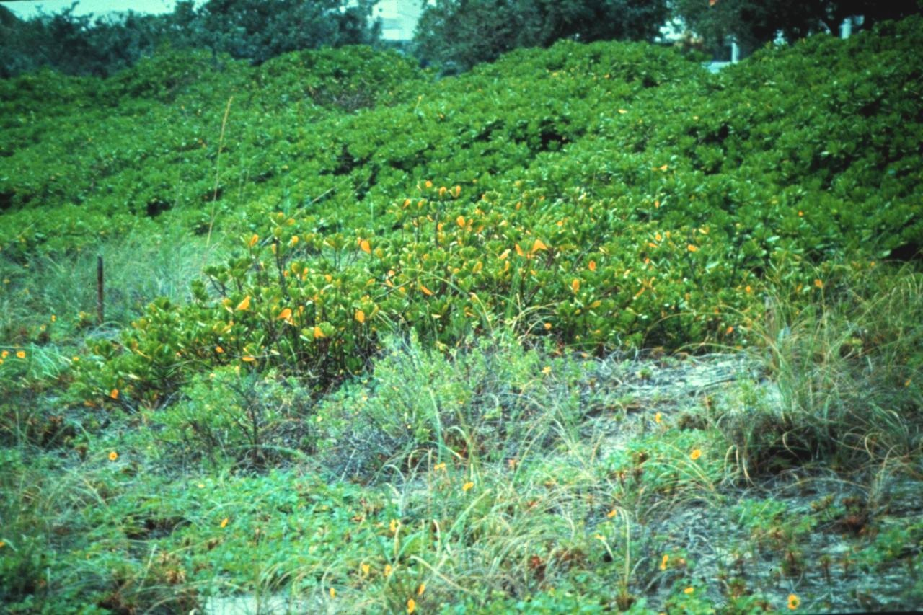
exotic
native
Invasive, beach Naupaka (Scaevola taccada) growing with native Inkberry (Scaevola plumieri).

Slide 25
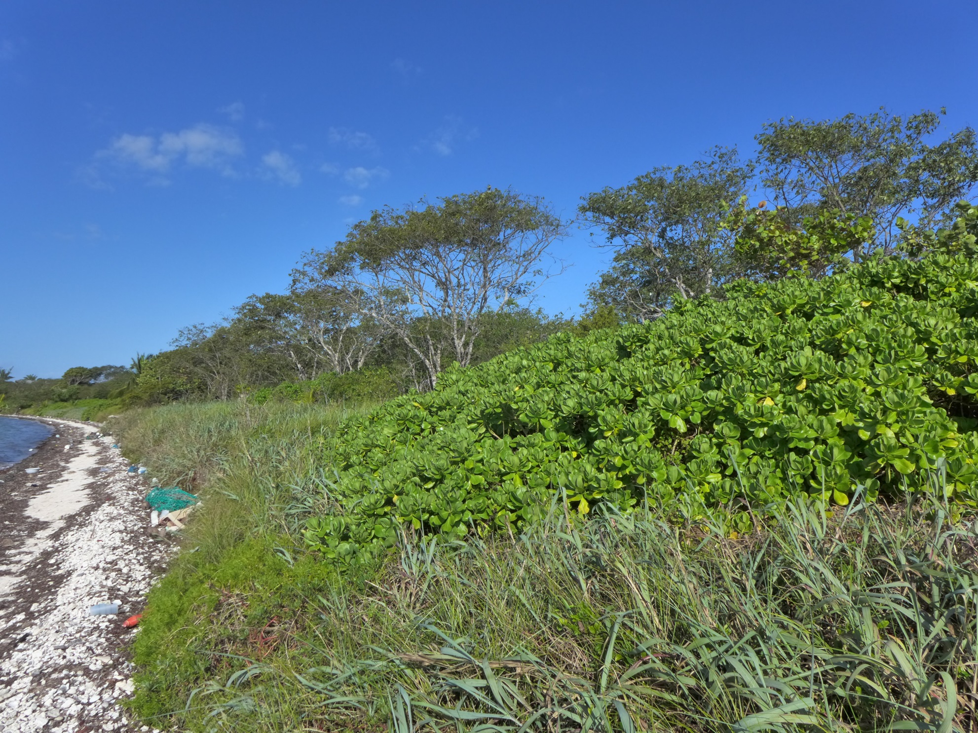
BEACH NAUPAKA
Scaevola taccada

Slide 26

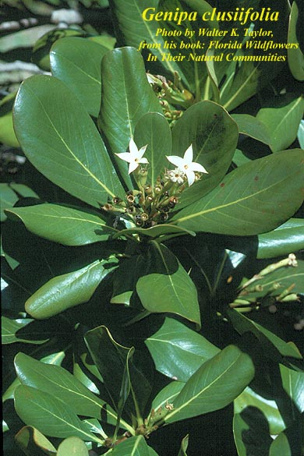
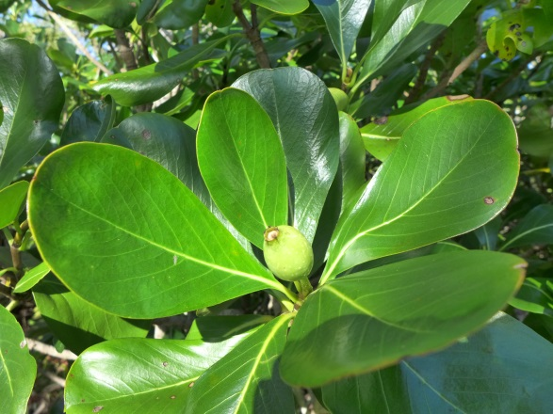
BEACH NAUPAKA
Scaevola taccada
SEVENYEAR APPLE
Genipa clusiifolia
Notes:
Similar growth habit, both with white flowers, leaves somewhat rolled

Slide 27
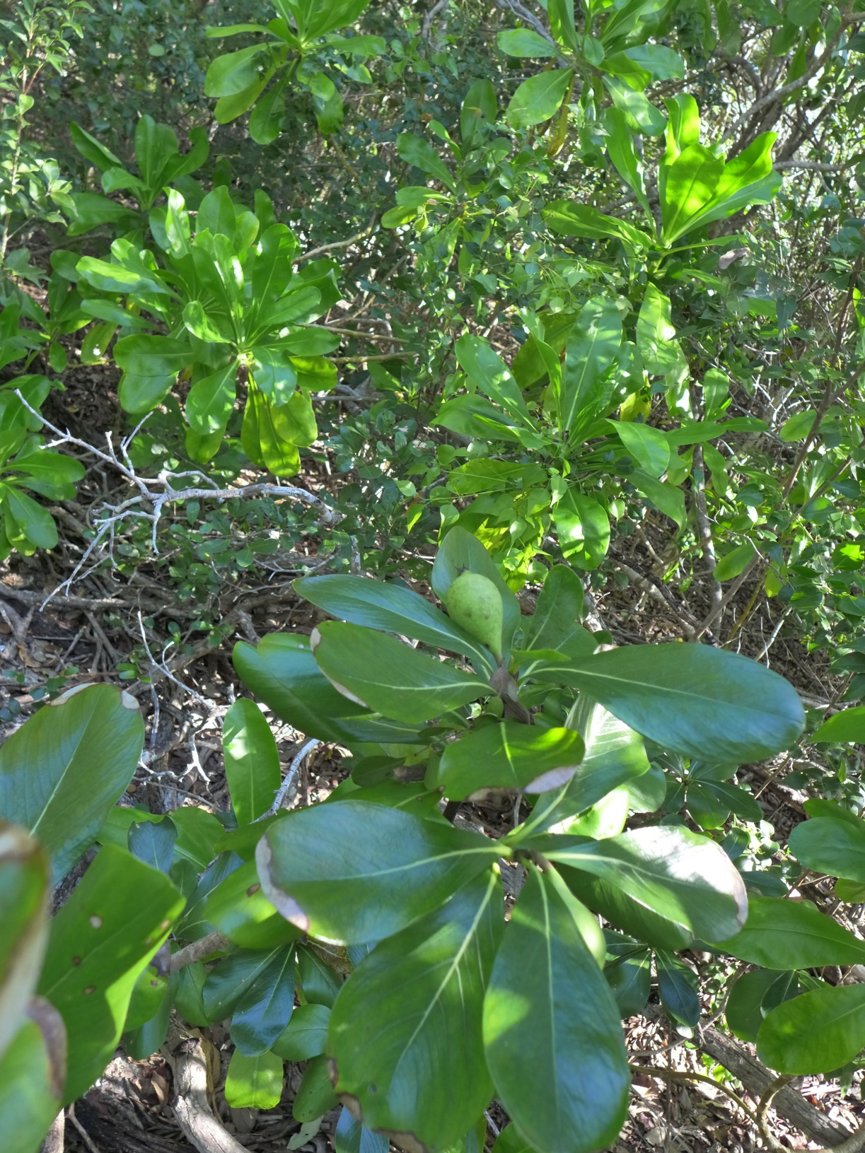
BEACH NAUPAKA
Scaevola taccada
SEVENYEAR APPLE
Genipa clusiifolia

Slide 28

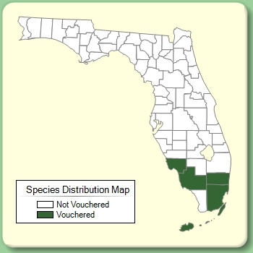
BEACH NAUPAKA
Scaevola taccada
SEVENYEAR APPLE
Genipa clusiifolia
Leaves alternate (but densely clustered)
White fruit
Fruit smaller
Flowers zygomorphic
Leaves opposite
Black fruit (green when immature)
Fruit larger (6-10cm)
Flowers actinomorphic

Slide 29
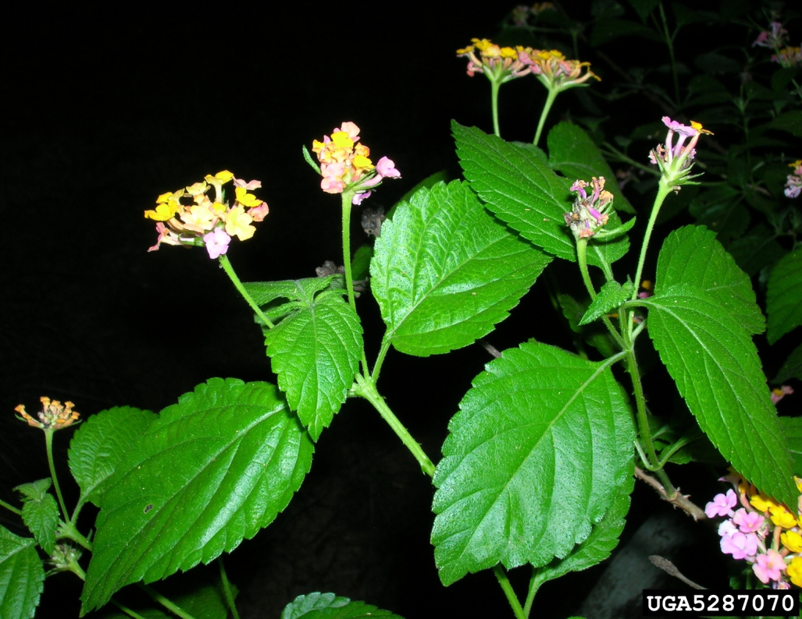

LANTANA
Lantana strigocamara
PINELAND LANTANA
Lantana depressa
Notes:
Lantana depressa is a state-endangered endemic species and these two have been documented hybridizing extensively.

Slide 30


LANTANA
Lantana camara
PINELAND LANTANA
Lantana depressa
Obtuse leaf base
Leaves more or less flat
Orange or multi-colored flowers
Acute leaf base
Leaves folded along midrib
All flowers yellow
Notes:
Can only be confused in Miami-Dade County (what about var. sanibelensis and var. floridana???)

Slide 31

LANTANA
Lantana camara

Slide 32


HEAVENLY BAMBOO
Nandina domestica
DEVIL’S WALKINGSTICK
Aralia spinosa
Notes:
Similarity: compound, alternate leaves, single trunk, white flowers in large clusters

Slide 33


HEAVENLY BAMBOO
Nandina domestica
DEVIL’S WALKINGSTICK
Aralia spinosa

Slide 34


HEAVENLY BAMBOO
Nandina domestica
DEVIL’S WALKINGSTICK
Aralia spinosa
Leaflet margin entire
Stem and leaves unarmed
Red berry
Leaflet margin serrate
Stem and leaves armed with prickles
Purple/black drupe

Slide 35

DEVIL’S WALKINGSTICK
Aralia spinosa

Slide 36

HEAVENLY BAMBOO
Nandina domestica

Slide 37




SILVERTHORN
Elaeagnus pungens
GUM BULLY
Sideroxylon lanuginosum
Notes:
Similar due to alternate leaves of similar size, short shoots/leafy thorns, twigs that appear rusty brown

Slide 38


SILVERTHORN
Elaeagnus pungens
GUM BULLY
Sideroxylon lanuginosum
Twigs and underside of leaf with silvery and rusty scales
Fruit a large berry covered with scales
No milky sap
Twigs and underside of leaf with soft hairs
Fruit a black berry
Milky sap

Slide 39




JAVA PLUM
Syzygium cumini
FALSE MASTIC
Sideroxylon foetidissimum
Notes:
Both evergreen trees mostly in the Southern peninsula with simple dark green leaves

Slide 40


JAVA PLUM
Syzygium cumini
FALSE MASTIC
Sideroxylon foetidissimum
Black fruit
Entire leaf margin
Opposite leaves
Lateral leaf veins quite faint
Yellow fruit
Wavy leaf margin
Alternate leaves
Lateral leaf veins more apparent

Slide 41


JAVA PLUM
Syzygium cumini
FALSE MASTIC
Sideroxylon foetidissimum
Notes:
Both evergreen trees mostly in the Southern peninsula with simple dark green leaves

Slide 42



CARROTWOOD
Cupaniopsis anacardioides
PARADISETREE
Simarouba glauca
Notes:
Both with alternate, even-pinnately compound leaves. Leaflets often have a notched apex. Note leaflets are not quite opposite of each other.

Slide 43


CARROTWOOD
Cupaniopsis anacardioides
PARADISETREE
Simarouba glauca

Slide 44


CARROTWOOD
Cupaniopsis anacardioides
PARADISETREE
Simarouba glauca
Leaves with 4-12 leaflets
Leaves green when young
Leaves yellowish-green
Inner bark orange
Orange, 3-lobed fruit
Leaves with 9-21 leaflets
Leaves red-orange when young
Leaves dark green
Inner bark not orange
Purplish/black fruit

Slide 45


CARROTWOOD
Cupaniopsis anacardioides
PARADISETREE
Simarouba glauca
Notes:
Adult growth forms not that different from each other.

Slide 46





STRAWBERRY GUAVA
Psidium cattleianum
POSSUMHAW
Viburnum nudum
Notes:
Both have opposite leaves, white flowers, red berries

Slide 47


STRAWBERRY GUAVA
Psidium cattleianum
POSSUMHAW
Viburnum nudum
Crushed leaves fragrant
Flowers/fruits axillary
Berries yellow or red
Berries with persistent, fleshy sepals at apex
Leaves not fragrant
Flowers/fruits terminal
Drupes purplish black
Drupes without sepals at apex
Notes:
Note only overlap in central FL.

Slide 48



STRAWBERRY GUAVA
Psidium cattleianum
WHITE STOPPER
Eugenia axillaris
Notes:
Both with fragrant opposite leaves (both myrtaceae). Both with axillary flowers/fruits

Slide 49

STRAWBERRY GUAVA
Psidium cattleianum
WHITE STOPPER
Eugenia axillaris
Yellowish to red berry
Pedicels 1-2 cm long, stout
Leaves mostly obovate
Short acuminate leaf apex
Black berry
Pedicels <0.5 cm long
Leaves ovate to elliptic
Acute leaf apex

Slide 50

SURINAM CHERRY
Eugenia uniflora
WHITE STOPPER
Eugenia axillaris
Notes:
Both with fragrant opposite leaves (both myrtaceae). Both with axillary flowers/fruits

Slide 51

SURINAM CHERRY
Eugenia uniflora
WHITE STOPPER
Eugenia axillaris

Slide 52

SURINAM CHERRY
Eugenia uniflora
WHITE STOPPER
Eugenia axillaris
Large, red ‘ribbed’ berry
Pedicels >0.5 cm long
Petiole very short (2-5 mm)
Small, black berry
Pedicels <0.5 cm long
Petiole longer and reddish

Slide 53




GUAVA
Psidium guajava
POND APPLE
Annona glabra
Notes:
Both with larger, 2-ranked leaves, and large fleshy fruits

Slide 54


GUAVA
Psidium guajava
POND APPLE
Annona glabra

Slide 55


GUAVA
Psidium guajava
POND APPLE
Annona glabra
Opposite leaves
Leaf veins prominent
Fruit with persistent, fleshy sepals at the apex
Alternate leaves
Leaf veins obscure
Fruit without persistent sepals

Slide 56






CAMPHOR TREE
Cinnamomum camphora
SWAMP BAY
Persea palustris
Notes:
Both with fragrant, alternate leaves that are light on the underside. Both with dark drupes. Both in Lauraceae family.

Slide 57


CAMPHOR TREE
Cinnamomum camphora
SWAMP BAY
Persea palustris
Crushed leaves have a strong camphor smell
Glaucous leaf underside
Three veins at leaf base
Fruit with a cupule
Crushed leaves have a bay leaf smell
Pubescent leaf underside
One vein at leaf base
Fruit lacking a cupule

Slide 58




LAUREL FIG
Ficus microcarpa
STRANGLER FIG
Ficus aurea
Notes:
Similarity – both with alternate leaves, milky sap, small fig fruits that are sessile, aerial roots

Slide 59


LAUREL FIG
Ficus microcarpa
STRANGLER FIG
Ficus aurea
Smaller leaves (4-6 cm long)
Veins obscure
Lowest pair of veins at a sharper angle than rest
Figs ca. 1 cm long
Larger leaves (6-12 cm long)
Veins yellowish
Lowest pair of veins not different
Figs ca. 2 cm long

Slide 60




LAUREL FIG
Ficus microcarpa
STRANGLER FIG
Ficus aurea

Slide 61




LEAD TREE
Leucaena leucocephala
WILD TAMARIND
Lysiloma latisiliquum
Notes:
Both legumes with compound leaves

Slide 62


LEAD TREE
Leucaena leucocephala
WILD TAMARIND
Lysiloma latisiliquum
Leaflet very asymmetrical
Legume narrower
10 stamens/flower
Stipules inconspicuous
Leaflet slightly asymmetrical
Legume wider
>10 stamens/flower
Stipules conspicuous, large on new growth

Slide 63


LEAD TREE
Leucaena leucocephala
WILD TAMARIND
Lysiloma latisiliquum
Bobby Hattaway / www.discoverlife.org
Notes:
Gland character also a good way to tell lead tree from silk tree, which has a gland near the base of the petiole

Slide 64



LEAD TREE
Leucaena leucocephala
WILD TAMARIND
Lysiloma latisiliquum
Gland at top of petiole (under first leaflets) on lead tree
Stipules at base of new leaves on wild tamarind
Notes:
Gland character also a good way to tell lead tree from silk tree, which has a gland near the base of the petiole

Slide 65


BRAZILIAN PEPPER
Schinus terebinthifolia*
DAHOON
Ilex cassine
Recent name change to match latin gender of Schinus
  …folius to …folia
Notes:
Both produce red drupes; but note compound versus simple leaf

Slide 66


BRAZILIAN PEPPER
Schinus terebinthifolia
DAHOON
Ilex cassine
Compound leaf
Crushed leaves have a pungent odor
Drupes with a single seed
Drupe without a black dot on top
Simple leaf
Crushed leaves are odorless
Drupes with four seeds
Fruit with a black dot on top (persistent stigma)

Slide 67




WHITE MULBERRY
Morus alba
RED MULBERRY
Morus rubra
Notes:
Very similar in appearance, closely related, may hybridize (according to Godfrey)

Slide 68


WHITE MULBERRY
Morus alba
RED MULBERRY
Morus rubra
Upper leaf surface glabrous
Lower leaf surface with hairs on veins or glabrous
Leaf apices abruptly acuminate
Leaves usually dark green
Upper leaf surface scabrous (with short hairs)
Lower leaf surface covered with soft hairs throughout
Leaf apices conspicuously acuminate
Leaves usually mid-green

Slide 69


WHITE MULBERRY
Morus alba
RED MULBERRY
Morus rubra
Notes:
Very similar in appearance, closely related, may hybridize (according to Godfrey)

Slide 70



PAPER MULBERRY
Broussonetia papyrifera
RED MULBERRY
Morus rubra
Notes:
Both with milky sap, leaves with three veins at base, serrate margin

Slide 71

PAPER MULBERRY
Broussonetia papyrifera
RED MULBERRY
Morus rubra
Clonal, thicket forming
Small twigs pubescent
Petioles often longer, up to the length of the leaf
Leaves usually dull green
Solitary
Small twigs glabrous, or with only a few hairs
Petioles 2 to 2.5 cm long
Leaves usually mid-green

Slide 72





SISAL HEMP
Agave sisalana
FALSE SISAL
Agave decipiens

Slide 73


SISAL HEMP
Agave sisalana
FALSE SISAL
Agave decipiens
Leaves entire
Leaves larger
  90-130 cm long
  9-12 cm wide
Upper leaf surface flat
Leaves w/ recurved teeth
Leaves smaller
  70-100 cm long
  7-10 cm wide
Upper leaf surface concave

Slide 74
FERNS
Ferns are a primitive plant group that do not produce flowers or fruits.
The leaves of ferns are often called fronds
Leaflets are called pinnae (1st order segments) or pinnules (2nd order or greater segments)

Slide 75



Sporangium (pl. sporangia)
Sorus (pl. sori)
Indusium

Slide 76



SWORD FERN
Nephrolepis cordifolia
WILD BOSTON FERN
Nephrolepis exaltata

Slide 77


SWORD FERN
Nephrolepis cordifolia
WILD BOSTON FERN
Nephrolepis exaltata
Roots with tubers
Scales on rachis two colors
Pinnae (leaflets) blunt-tipped
Roots lacking tubers
Scales on rachis one color
Pinnae more pointed at apex

Slide 78




SWORD FERN
Nephrolepis cordifolia
WILD BOSTON FERN
Nephrolepis exaltata

Slide 79


SWORD FERN
Nephrolepis cordifolia
PLUME POLYPODY
Pecluma plumula

Slide 80


SWORD FERN
Nephrolepis cordifolia
PLUME POLYPODY
Pecluma plumula
Rarely epiphytic
Pinnae serrate
Kidney-shaped indusium
Usually epiphytic
Pinnae entire
No indusium
Notes:
In many species each sorus is covered by a thin, often membranous structure called an indusium (plural = indusia).

Slide 81


SWORD FERN
Nephrolepis cordifolia
PLUME POLYPODY
Pecluma plumula
Notes:
indusium a thin, often membraneous structure covering each sorus.

Slide 82
Herbs and
GRASSES

Slide 83


RATTLEBOX
Sesbania punicea
BLADDERPOD
Sesbania vesicaria

Slide 84


Rattlebox
Sesbania punicea
Bladderpod
Sesbania vesicaria
Plants woody
Flowers yellowish in center, but without distinctive eye
Fruit 4-angled
Plants mainly herbaceous
Flowers yellow to tri-colored with a distinctive yellow eye
Fruit flattened (2-angled)

Slide 85




Rattlebox
Sesbania punicea
Bladderpod
Sesbania vesicaria

Slide 86




Peruvian primrosewillow
Ludwigia peruviana
Anglestem primrosewillow
Ludwigia leptocarpa

Slide 87


Peruvian primrosewillow
Ludwigia peruviana
Anglestem primrosewillow
Ludwigia leptocarpa
Overall larger plant/shrub
Larger flower
Usually 4 petals
Fruits square, broad, to 3 cm long
Smaller plant/herb
Smaller flower
Usually 5 petals
Fruits narrowly cylindrical, to 5 cm long

Slide 88




Peruvian primrosewillow
Ludwigia peruviana
Anglestem primrosewillow
Ludwigia leptocarpa

Slide 89




Praxelis
Praxelis clematidea
Blue mistflower
Conoclinium coelestinum

Slide 90


Praxelis
Praxelis clematidea
Blue mistflower
Conoclinium coelestinum
Crushed leaves have a pungent odor of cat urine
Phyllaries deciduous (absent in fruit)
Flower heads more than 0.5 cm long
Crushed leaves may be fragrant, but not of cat urine
Phyllaries persistant (present in fruit)
Flower heads less than 0.5 cm long

Slide 91



A note about grasses
Grasses (Poaceae) have a special leaf structure consisting of
1) the blade – the part of the leaf above the sheath,
2) the sheath – the lower part of the leaf that envelops the stem,
3) the ligule – a flap-like membrane or line of hairs on the inside of the leaf at the junction of the blade and the sheath.
Membranous
Ciliate

Slide 92



COGON GRASS
Imperata cylindrica
BROOMSEDGE BLUESTEM
Andropogon virginicus
Notes:
Both perennial grasses to about 4 feet tall, with flat, erect, leaf blades.

Slide 93


COGON GRASS
Imperata cylindrica
BROOMSEDGE BLUESTEM
Andropogon virginicus
Rhizomatous
Midvein of leaf white and often offset
Clumping
Midvein of leaf usually centered

Slide 94


COGON GRASS
Imperata cylindrica
BROOMSEDGE BLUESTEM
Andropogon virginicus

Slide 95



COGON GRASS
Imperata cylindrica
YELLOW INDIANGRASS
Sorghastrum nutans

Slide 96


COGON GRASS
Imperata cylindrica
YELLOW INDIANGRASS
Sorghastrum nutans
Midvein of leaf white and often offset
Ligule short (0.2-3.5 mm)
Large fuzzy panicle of flowers, silvery white and cylindrical
Midvein of leaf usually centered
Ligule long (2-6 mm)
Plume-like panicle of flowers, bronze yellow

Slide 97


COGON GRASS
Imperata cylindrica
YELLOW INDIANGRASS
Sorghastrum nutans

Slide 98



TORPEDO GRASS
Panicum repens
MAIDENCANE
Panicum hemitomon

Slide 99


TORPEDO GRASS
Panicum repens
MAIDENCANE
Panicum hemitomon
Plants shorter (20-90 cm tall), leaves narrower
Rhizomes sharp-pointed
Inflorescence broader
Plants taller (50-200 cm tall), leaves broader
Rhizomes not sharp
Inflorescence narrow (to 1 cm wide)

Slide 100


WEST INDIAN MARSH GRASS
Hymenachne amplexicaulis
MAIDENCANE
Panicum hemitomon

Slide 101

WEST INDIAN MARSH GRASS
Hymenachne amplexicaulis
MAIDENCANE
Panicum hemitomon
Ligules 1-2.5 mm long
Internodes with solid white pith
Base of leaf blade clasping
Ligules <1 mm long
Internodes without solid white pith
Base of leaf cordate

Slide 102



WEST INDIAN MARSH GRASS
Hymenachne amplexicaulis
MAIDENCANE
Panicum hemitomon

Slide 103

WEST INDIAN MARSH GRASS
Hymenachne amplexicaulis
AMERICAN CUPSCALE
Sacciolepis striata

Slide 104

WEST INDIAN MARSH GRASS
Hymenachne amplexicaulis
AMERICAN CUPSCALE
Sacciolepis striata
Ligules 1-2.5 mm long
Internodes with solid white pith
Base of leaf blade clasping
Ligules <1 mm long
Internodes without solid white pith
Base of leaf cordate

Slide 105


BURMA REED
Neyraudia reynaudiana
COMMON REED
Phragmites australis
Notes:
Both large grasses with bushy panicles

Slide 106


BURMA REED
Neyraudia reynaudiana
COMMON REED
Phragmites australis
Ligules on both sides of leaf (line of hairs around collar)
Glabrous internodes
Ligule only on inside of leaf
Pubescent internodes

Slide 107


NAPIER GRASS
Pennisetum purpureum
COMMON REED
Phragmites australis
Notes:
Both large cane-like grasses (Napier to around 4 m tall, Common Reed to around 6 m tall)

Slide 108

NAPIER GRASS
Pennisetum purpureum
COMMON REED
Phragmites australis
Ligules 1.5 to 5 mm long
Inflorescence a dense terminal panicle
Ligules about 1 mm long
Inflorescence a bushy panicle

Slide 109

NAPIER GRASS
Pennisetum purpureum
COMMON REED
Phragmites australis

Slide 110


NAPIER GRASS
Pennisetum purpureum
COMMON REED
Phragmites australis
Ligule on Napier grass
Ligule on common reed

Slide 111



GOLDEN BAMBOO
Phyllostachys aurea
SWITCHCANE
Arundinaria gigantea

Slide 112


GOLDEN BAMBOO
Phyllostachys aurea
SWITCHCANE
Arundinaria gigantea
Stem flattened or grooved on one side just above the node
Swollen band just below node
Stem round
Node may be swollen, but lacking a swollen band just below the node

Slide 113


Tropical Nutrush
Scleria microcarpa
Tall Nutgrass
Scleria triglomerata

Slide 114


Tropical Nutrush
Scleria microcarpa
Tall Nutgrass
Scleria triglomerata
Leaf sheath strongly winged
Achenes in multiple lax racemes
Achenes with a large “cupula” at base
Stem sharply angled, but leaf sheath not winged
Achenes in 1 to several clusters
Achenes with 3-lobed disk at base and subtended by bracts, but no “cupula”

Slide 115







Tropical Nutrush
Scleria nicrocarpa
Tall Nutgrass
Scleria triglomerata

Slide 116
VINES

Slide 117


CHINESE WISTERIA
Wisteria sinensis
AMERICAN WISTERIA
Wisteria frutescens

Slide 118


CHINESE WISTERIA
Wisteria sinensis
AMERICAN WISTERIA
Wisteria frutescens
Leaves longer (to 40 cm)
Flowers just before or as leaves are emerging
Inflorescence longer (up to 40 cm long)
Leaves shorter (to 30 cm)
Flowers after leaves have appeared
Inflorescence shorter (up to 25 cm long)

Slide 119


CHINESE WISTERIA
Wisteria sinensis
AMERICAN WISTERIA
Wisteria frutescens

Slide 120



AIR-POTATO
Dioscorea bulbifera
FLORIDA YAM
Dioscorea floridana

Slide 121


AIR-POTATO
Dioscorea bulbifera
FLORIDA YAM
Dioscorea floridana
Stems have aerial tubers
Leaves larger, 9-11 nerved
Secondary veins often prominent
Stems lacking tubers
Leaves smaller, 7 nerved
Secondary veins less prominent

Slide 122



JAPANESE HONEYSUCKLE
Lonicera japonica
TRUMPET HONEYSUCKLE
Lonicera sempervirens

Slide 123


JAPANESE HONEYSUCKLE
Lonicera japonica
TRUMPET HONEYSUCKLE
Lonicera sempervirens
Leaves pubescent or glabrous, but not glaucous
Leaf apex acute to slightly acuminate
Flowers white to creamy yellow
Leaves with a glaucous underside
Leaf apex rounded
Flowers red
Notes:
Coral honeysuckle has glabrous leaves and young stems and red flowers.
Japanese honeysuckle has pubescent leaves and young stems and yellow/white flowers

Slide 124



JAPANESE HONEYSUCKLE
Lonicera japonica
TRUMPET HONEYSUCKLE
Lonicera sempervirens

Slide 125




BEACH VITEX
Vitex rotundifolia
RAILROAD VINE
Ipomoea pes-caprae ssp. brasiliensis
Notes:
Both plants have ground running, stoloniferous habits on beach dune habitats.

Slide 126


BEACH VITEX
Vitex rotundifolia
RAILROAD VINE
Ipomoea pes-caprae ssp. brasiliensis
Opposite leaves
Woody growth
Panicles of smaller blue flowers
Alternate leaves
Herbaceous
Solitary, “morning glory” flowers
Notes:
Beach vitex has opposite leaves with no indentation at tip. Beach vitex is woody like other member of the genus.
Railroad vine is a sweet potato relative, alternate leaves with characteristic notch at end of leaf, somewhat like a ‘goat’s foot’ hoof. Vine may be tough and suffretescent at base above root, but majority of plant is herbaceous. Flowers are solitary and last less than 1 day.
Beach vitex known from coastal Franklin and St. John’s counties, too, but not vouchered.

Slide 127




BEACH VITEX
Vitex rotundifolia
RAILROAD VINE
Ipomoea pes-caprae ssp. brasiliensis
Notes:
Beach vitex has opposite leaves with no indentation at tip. Beach vitex is woody like other member of the genus.
Railroad vine is a sweet potato relative, alternate leaves with characteristic notch at end of leaf, somewhat like a ‘goat’s foot’ hoof. Vine may be tough and suffretescent at base above root, but majority of plant is herbaceous. Flowers are solitary and last less than 1 day.

Slide 128


THANK YOU!!
Kim Alexander kalexander@fnai.fsu.edu
Dexter Sowell dsowell@fnai.fsu.edu
Chad Anderson canderson@fnai.fsu.edu

